Slide 1
Digital Storytelling
http://bit.ly/Talila
focus Terra, Zurich
Anatomia museum Complutense University, Madrid
Sakhnin,
Environmental Science center,
Israel
Chulola, Ethnobotanical Garden, Puebla, Mexico.

Slide 2
Create Your Digital Story Around the Museum
http://bit.ly/Talila
Comment
Test
survey
mission
Scientific data
Tags
Picture
Information
Location
Comment
Rating

Slide 3
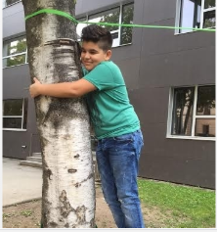
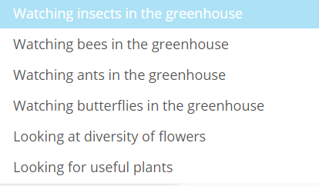
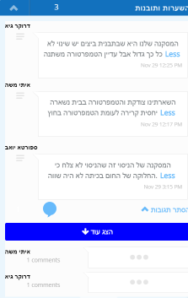
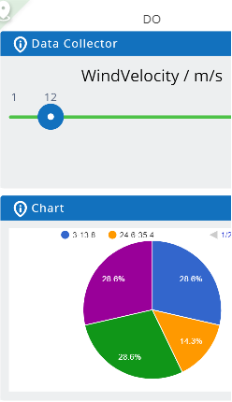
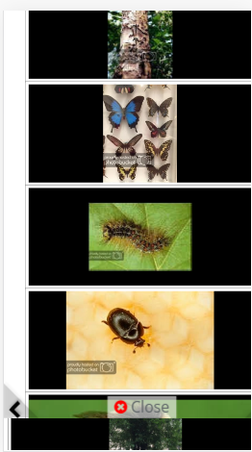
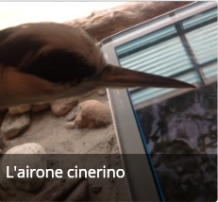
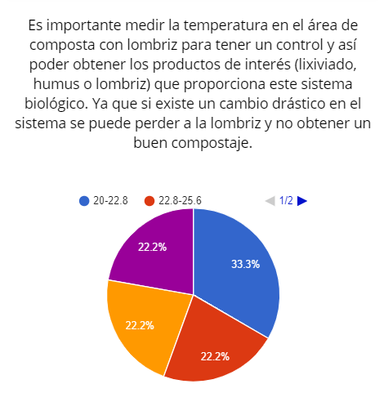
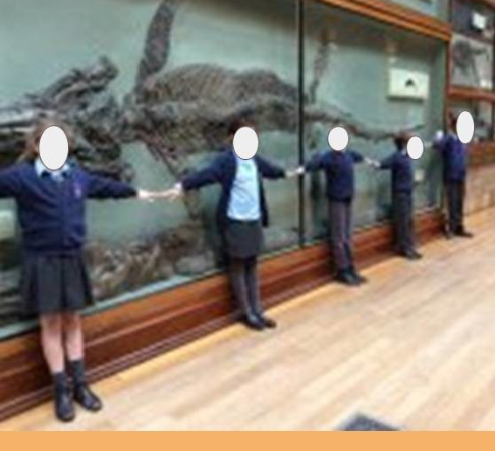
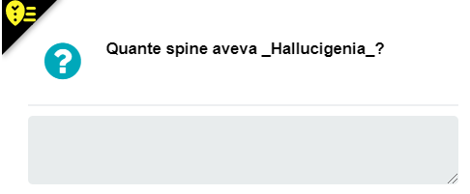
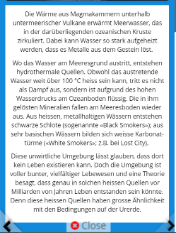
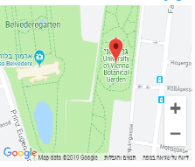
Interaction components
http://bit.ly/Talila
Comment

Slide 4
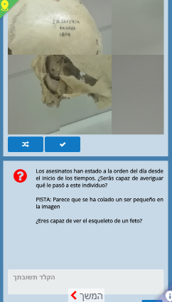
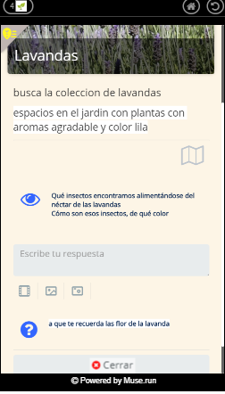
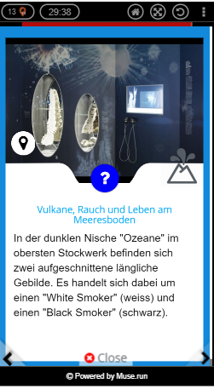
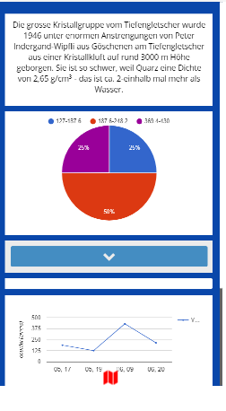
Location Interactive Learning Object = LILO
http://bit.ly/Talila

Slide 5
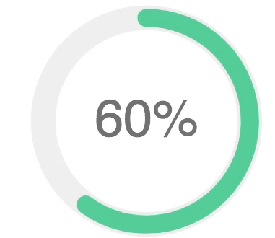
Dependencies
http://bit.ly/Talila

Slide 6
Rules
http://bit.ly/Talila

Slide 7
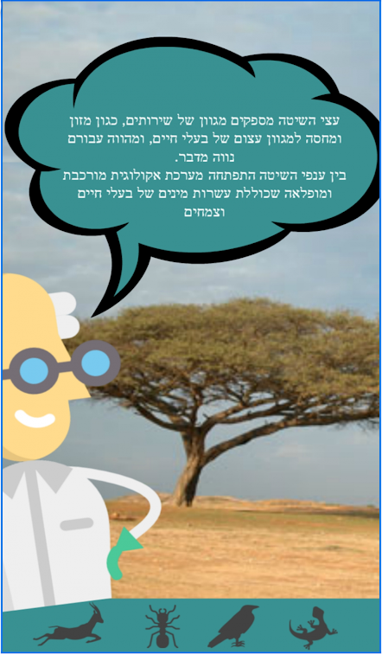
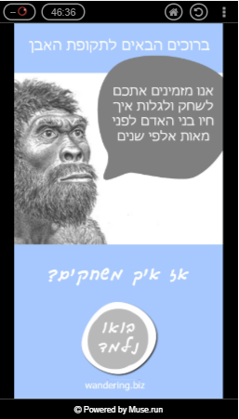
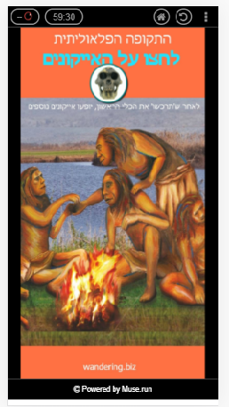
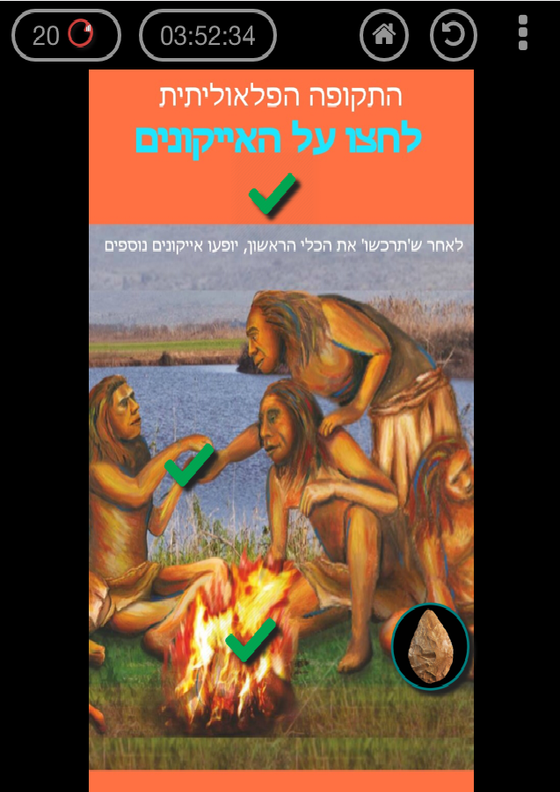
http://bit.ly/Talila
Scenes
Welcome to the Stone Age
The Acacia raddiana trees are oasis to many organisms and animals who can eat from the leaves and enjoy the shadow.
You are going to explore the tree and its elaborated ecosystem.
You are invited to find out how people lived many years ago.
How do we play?
Let’s Start

Slide 8
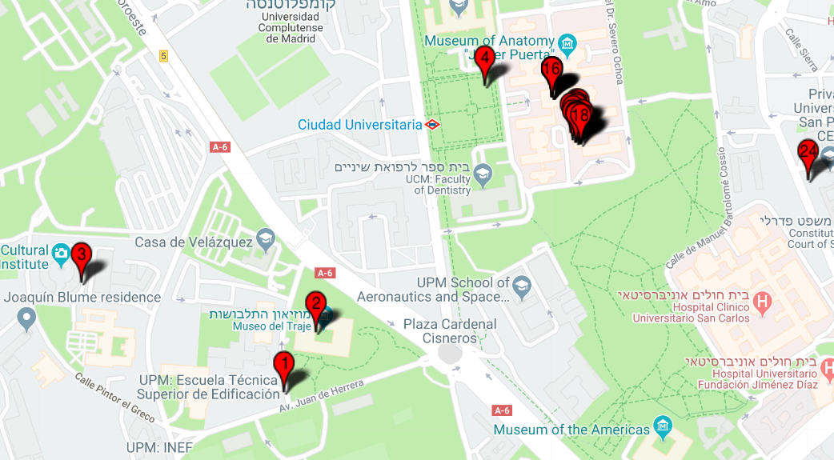
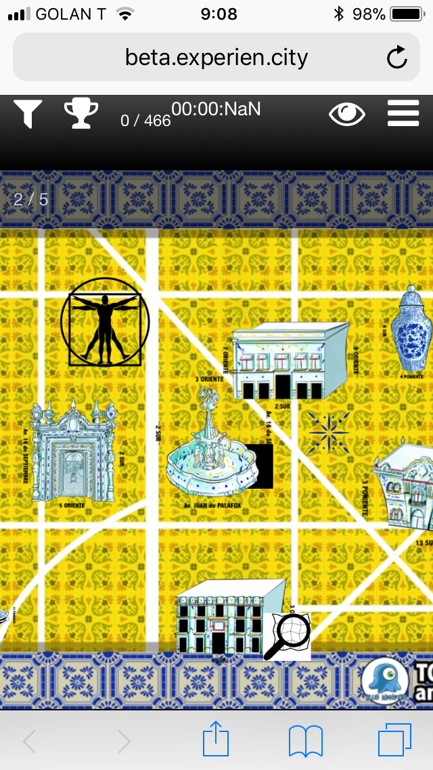
http://bit.ly/Talila
Interactive City map
Complutense university, Madrid , Spain
Puebla, Mexico

