Slide 1
Re-thinking collaboration with scientists
Yuri Matteman, 10 June 2016

Slide 2
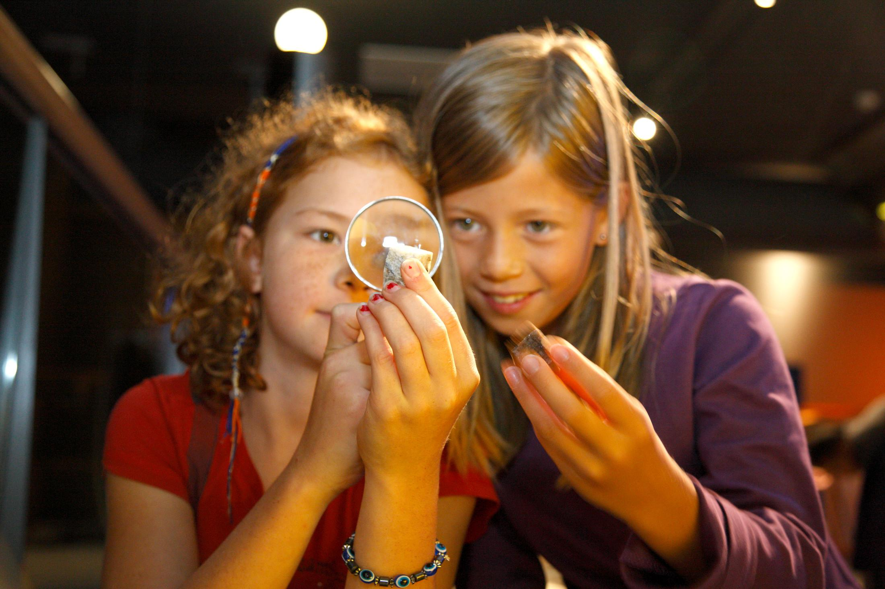
Educational mission
We will discover biodiversity together. What- ever you feel, whatever you know, there is always more to be thrilled about, more to learn and more to investigate.
Notes:
The Mission of Naturalis is:
We want to describe, understand and explore biodiversity for human well being and the future of our planet.
Key promise
Each contact with Naturalis increases my enthusiasm for and knowledge of the amazing diversity of nature.
That is a great promise because understanding and love for nature makes people change their attitude and behaviour towards it. This is also our educative goal. This doesn’t happen for everybody. It starts with wonder and motivation. That inspired us for this educative mission:
We will discover biodiversity together. Whatever you feel, whatever you know, there is always more to be enthusiastic about, more to learn and more to discover.

Slide 3
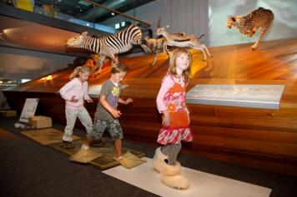
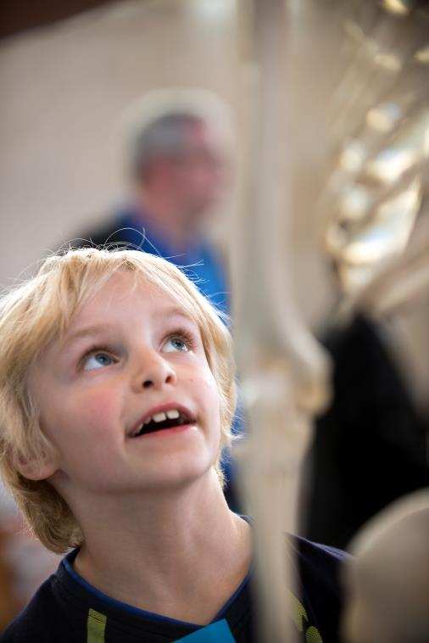
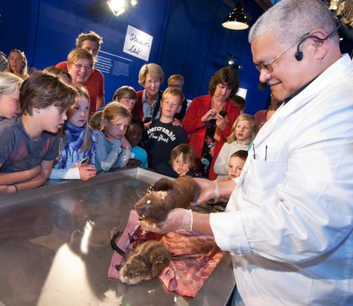
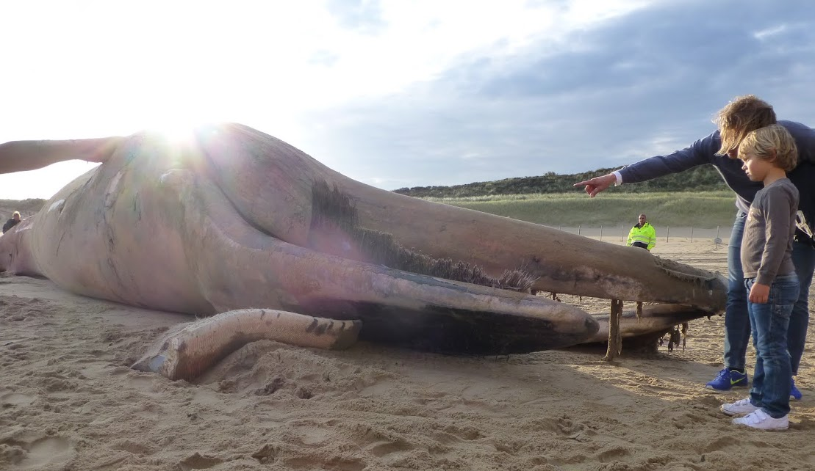
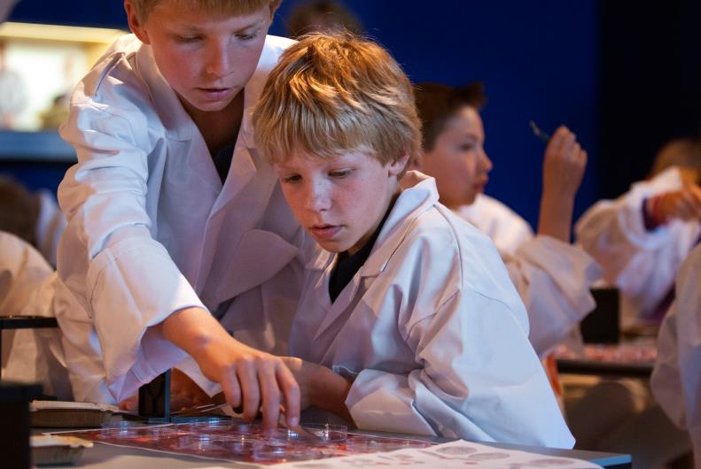
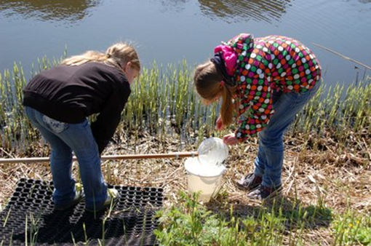
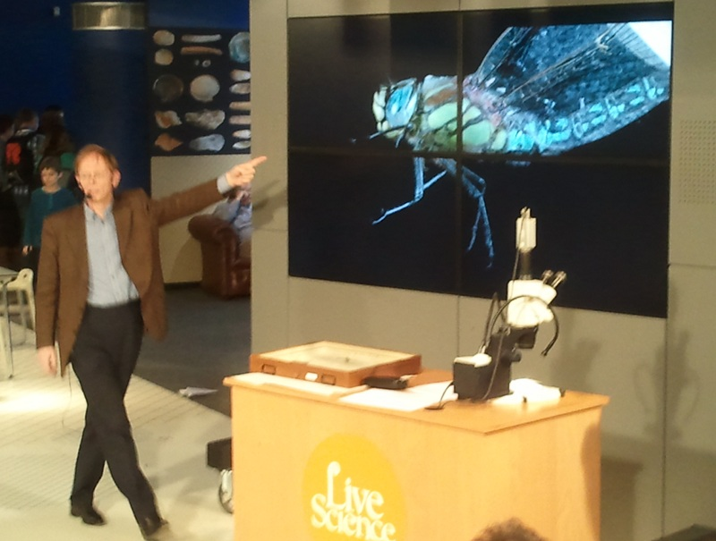
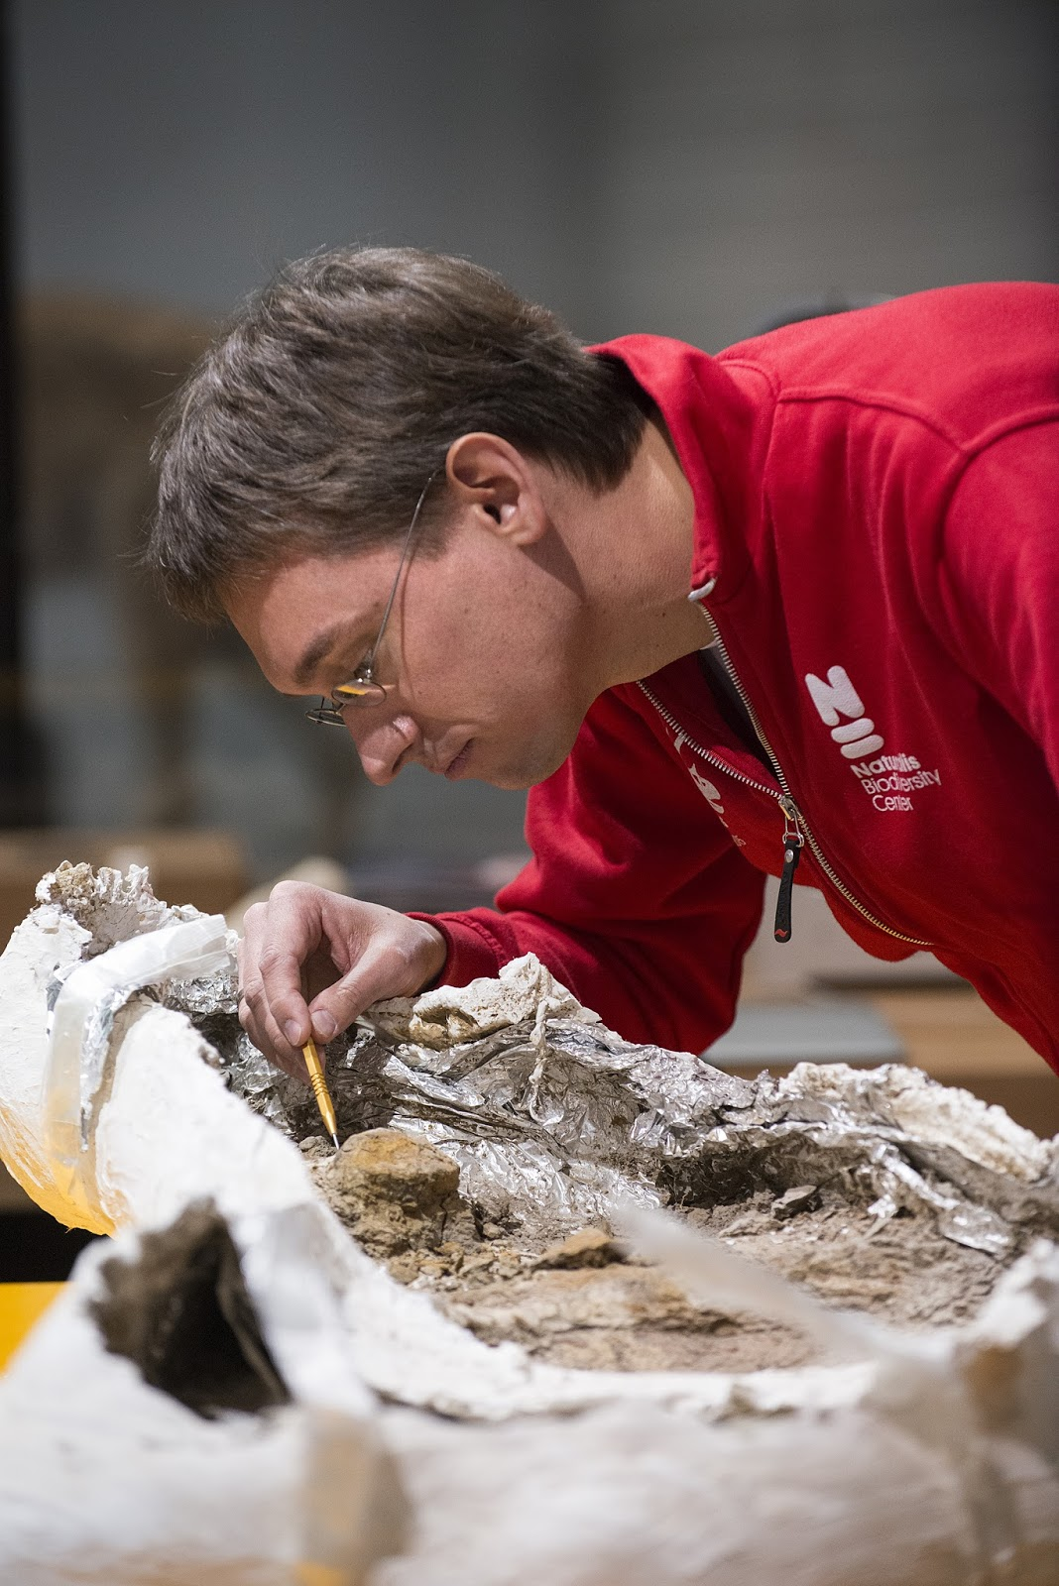
Big Five
Relevant
Real
Wonderment
Inquiry
scientific literacy

Slide 4
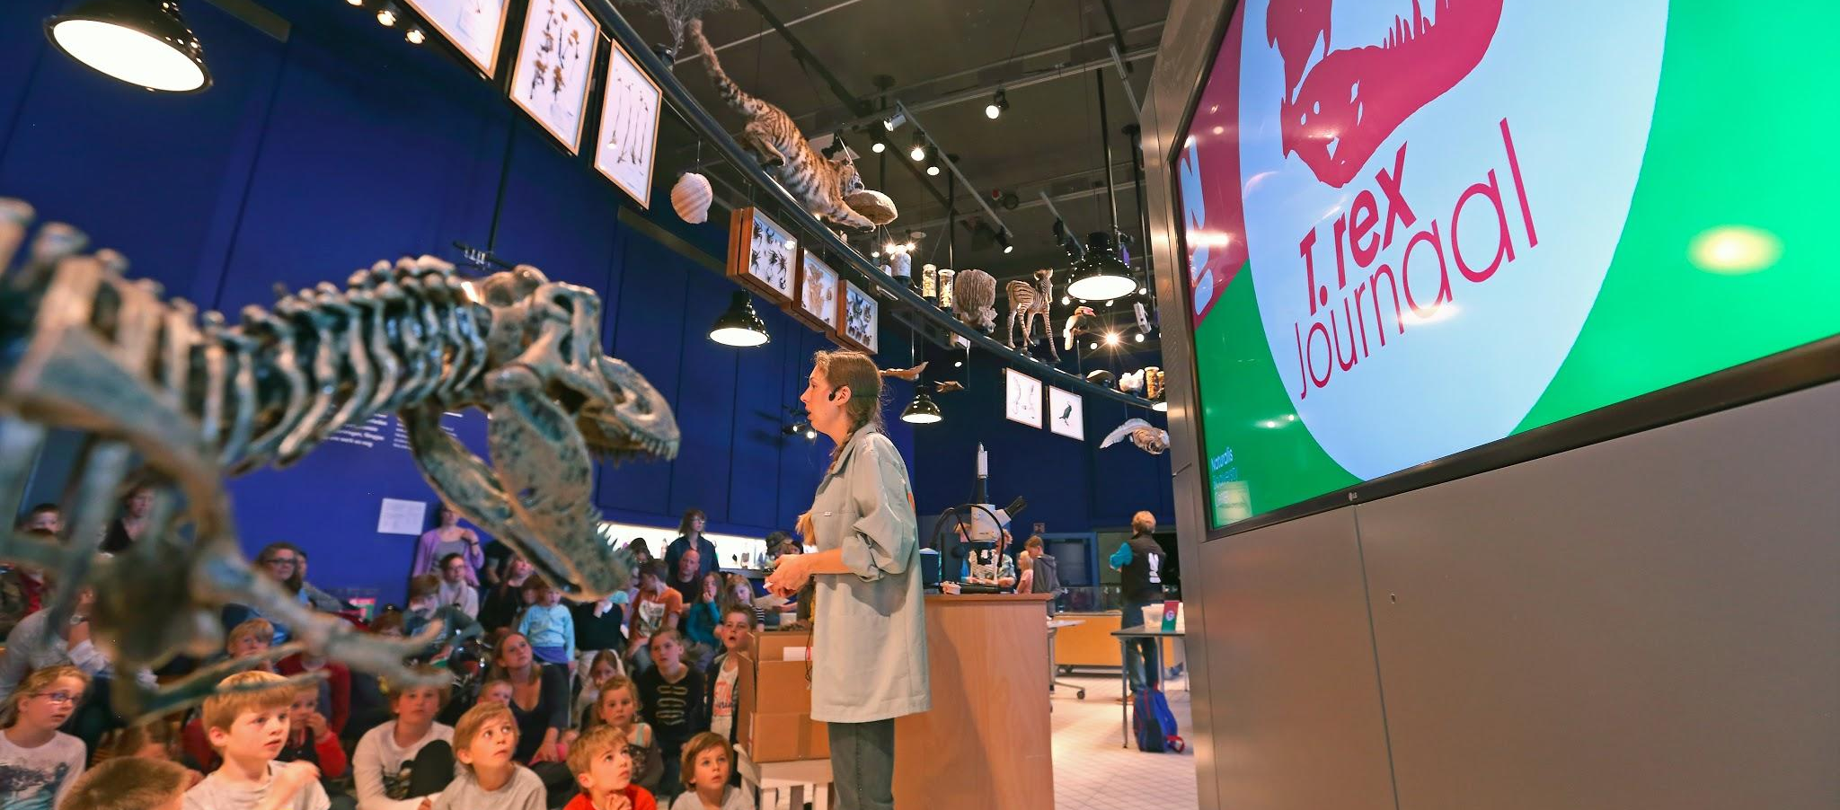
Scientific Literacy
A person can ask, find, or determine answers to questions derived from curiosity about everyday experiences and be critical about these answers.
Notes:
Scientists do research to understand and describe the world. They are curious and use different skills to find answers: raising questions, observing, interpreting, critical thinking, explaining , presenting etc.
Young children do the same. They do research to understand the world. They ask a lot of questions. That is why inquiry based learning suits us very good.
I think the best example of an educative product that conrtibutes to scientific literacy is our interactive T. rex news in which we present the latest news about the research on T. rex. We ask people what they want to investigate about T. rex and what their ideas are about questions our paleontologists don’t know the answers to. Research questions addressed to in the in the latest news are: how old was she?, was she smart?, how come that the skeleton is so well preserved? In the T. rex exhibition we don’t have enough space for the T.rex news, we are thinking about possibilities to programme this on special occasions and maybe develop an online version.

Slide 5
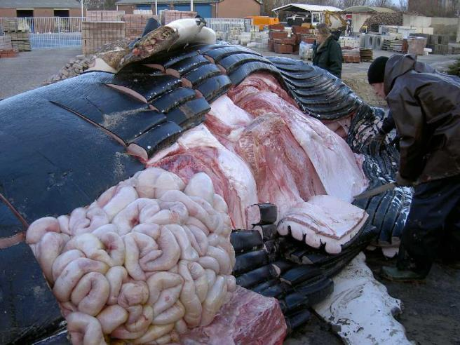
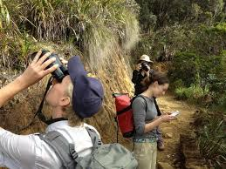
Naturalis scientists
±130 scientists
Understanding Evolution
Biodiversity discovery
Marine biodiversity
Endless forms
Biodiversity dynamics
Taxonomy & Systematics
Involvement
Concept and development
Active participation
Passive participation
(Educational science)

Slide 6
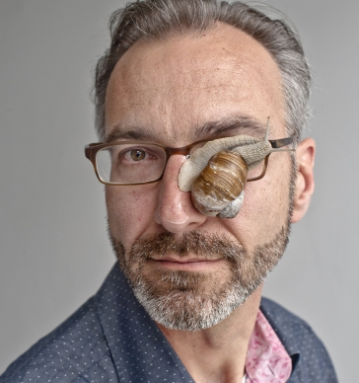
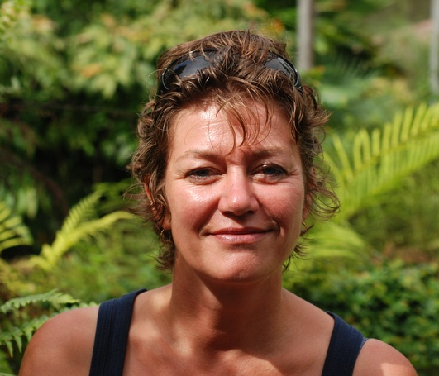
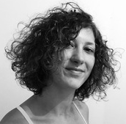
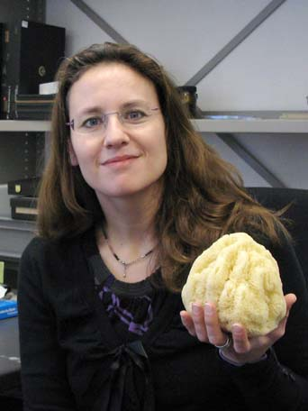
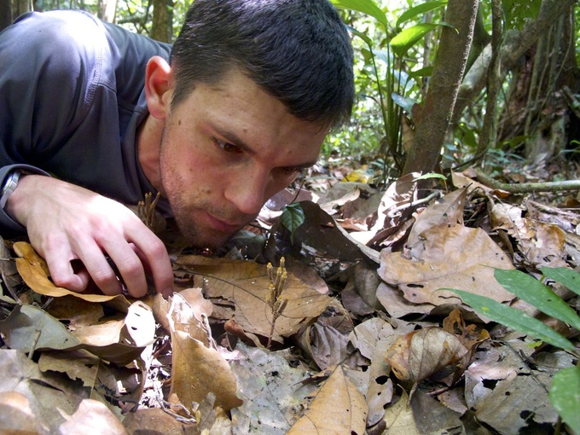
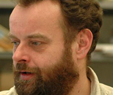
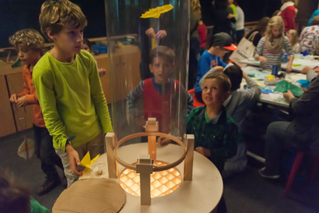
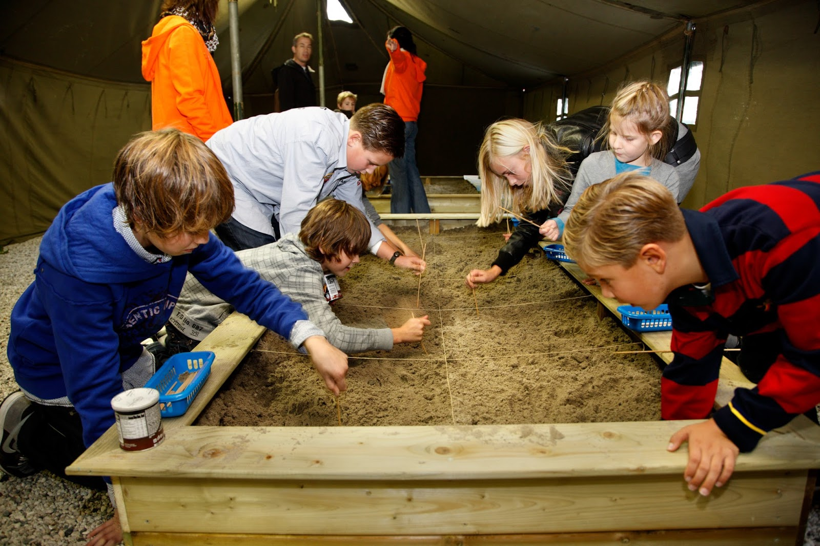
Content development

Slide 7
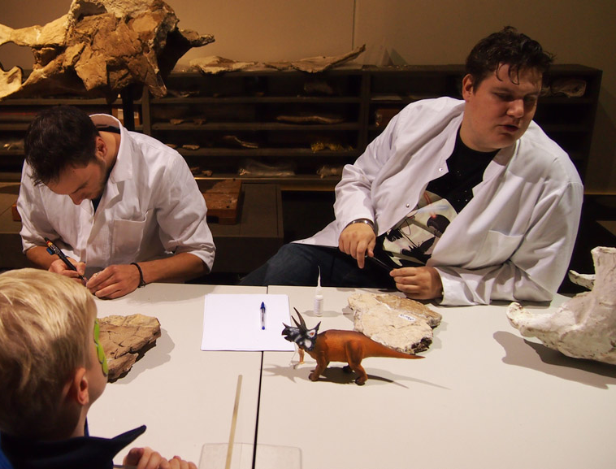
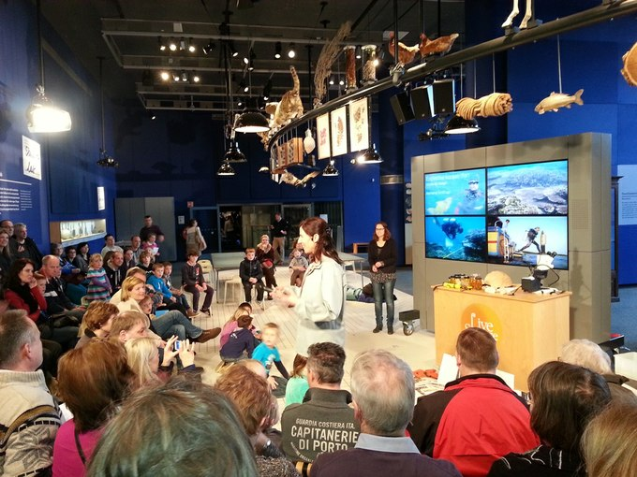
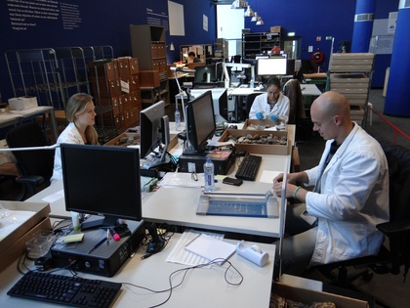
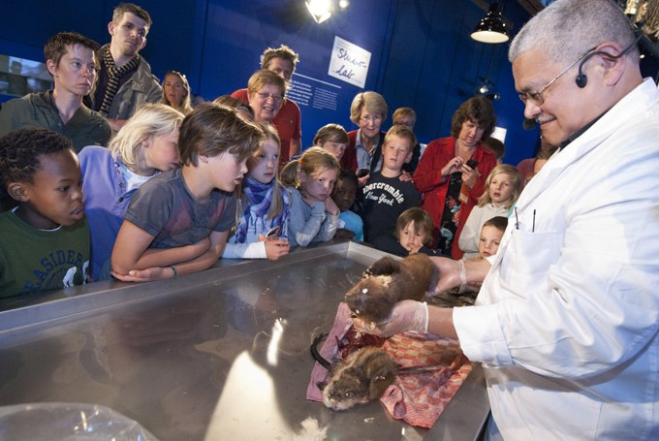
LiveScience

Slide 8
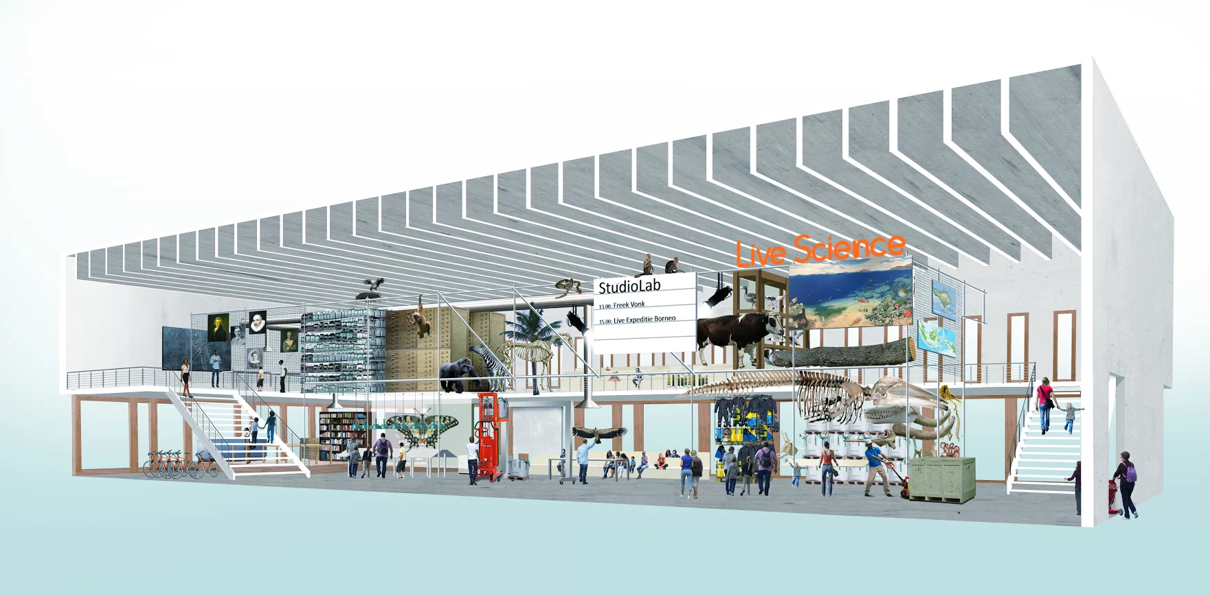
LiveScience

Slide 9
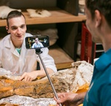
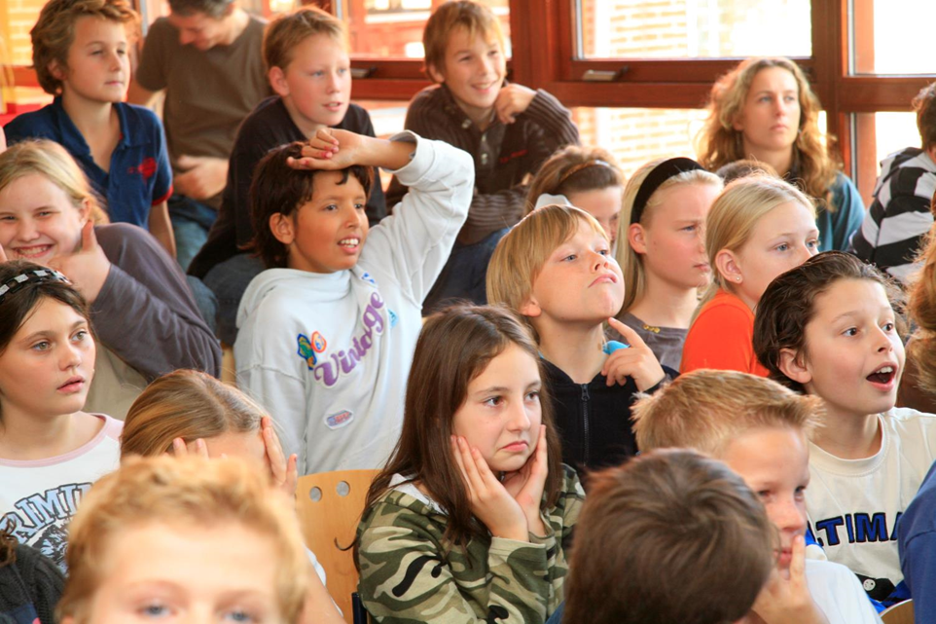
Online lessons

Slide 10
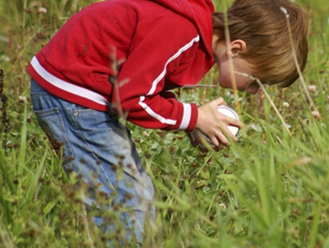
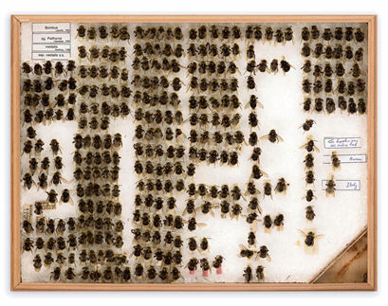
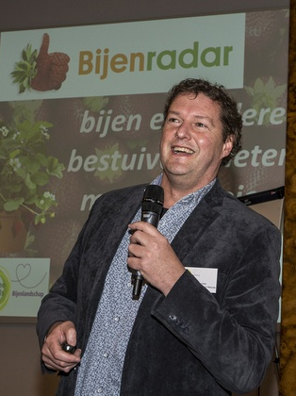
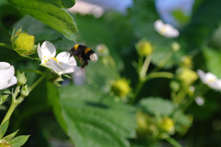
Citizen science

Slide 11
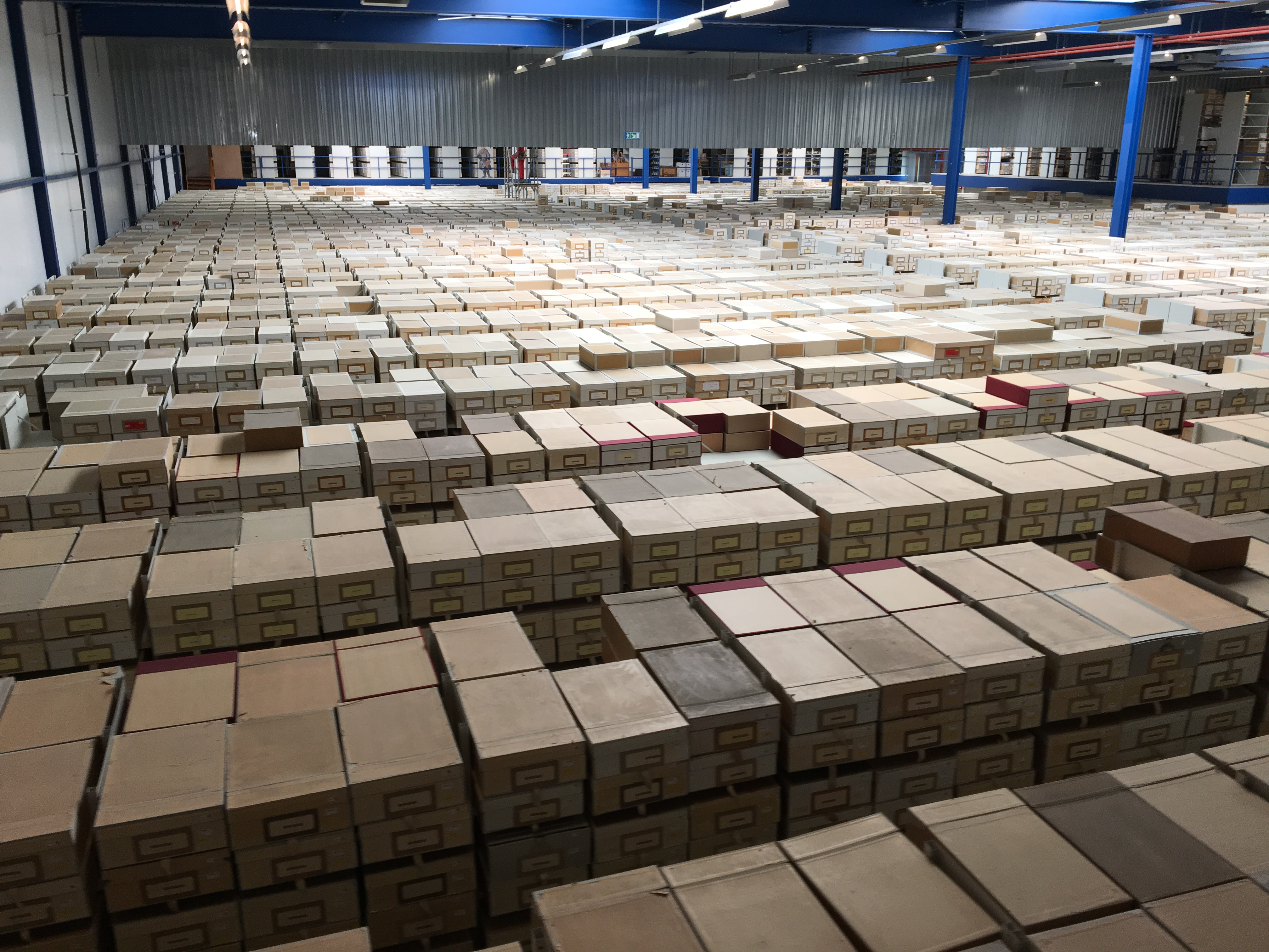
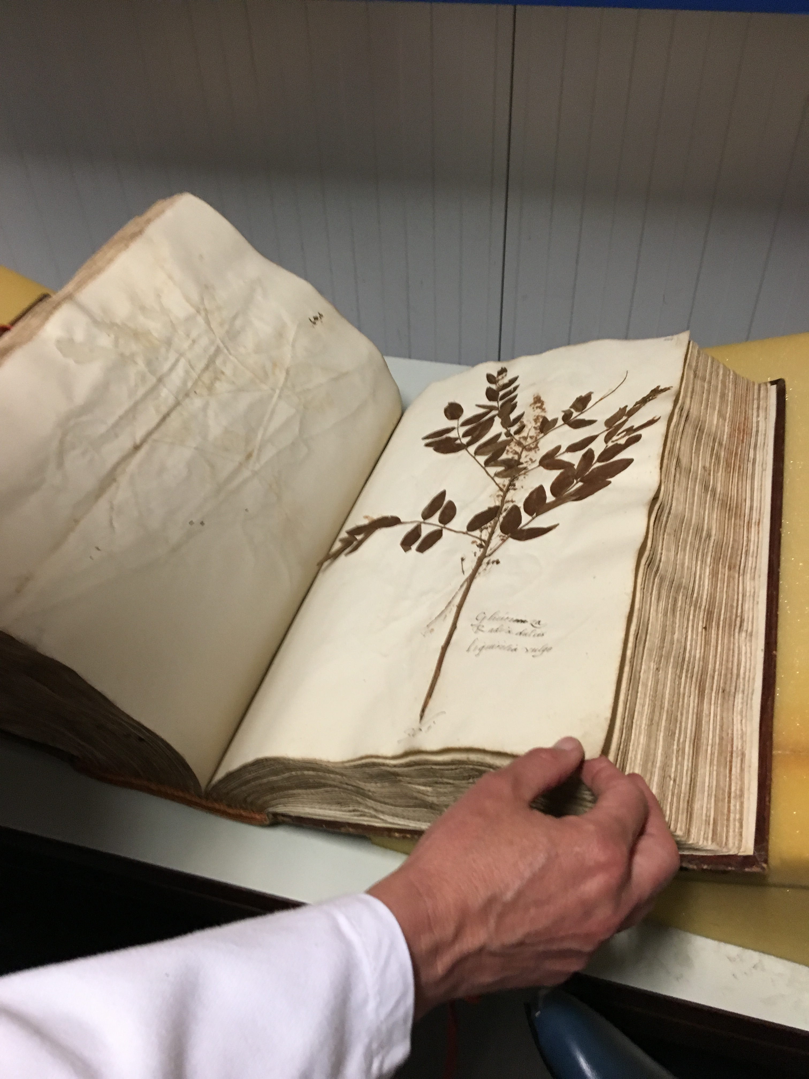
Outreach and valorisation

Slide 12
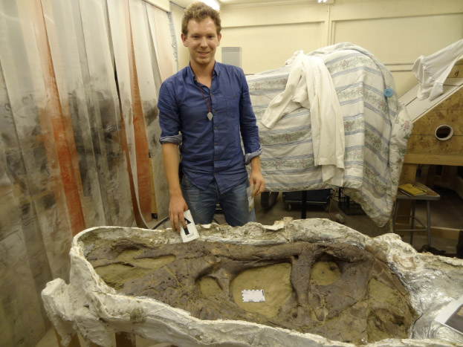
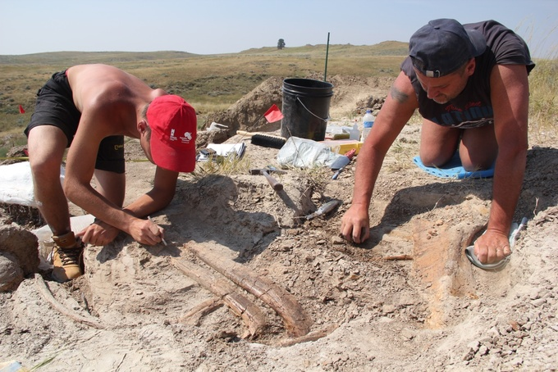
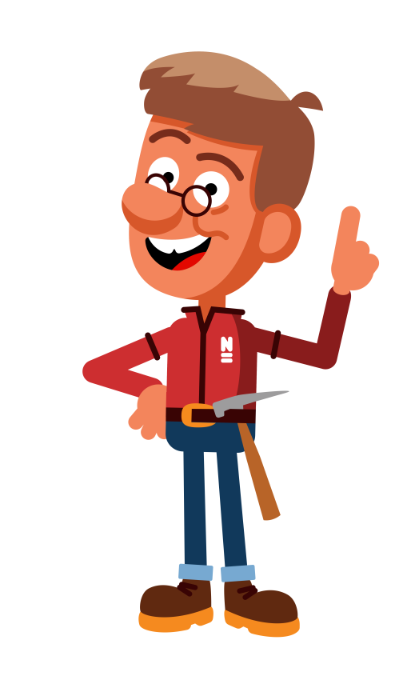
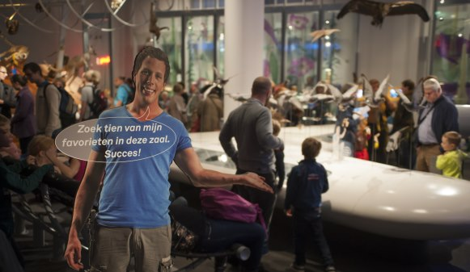
As rolemodels

Slide 13
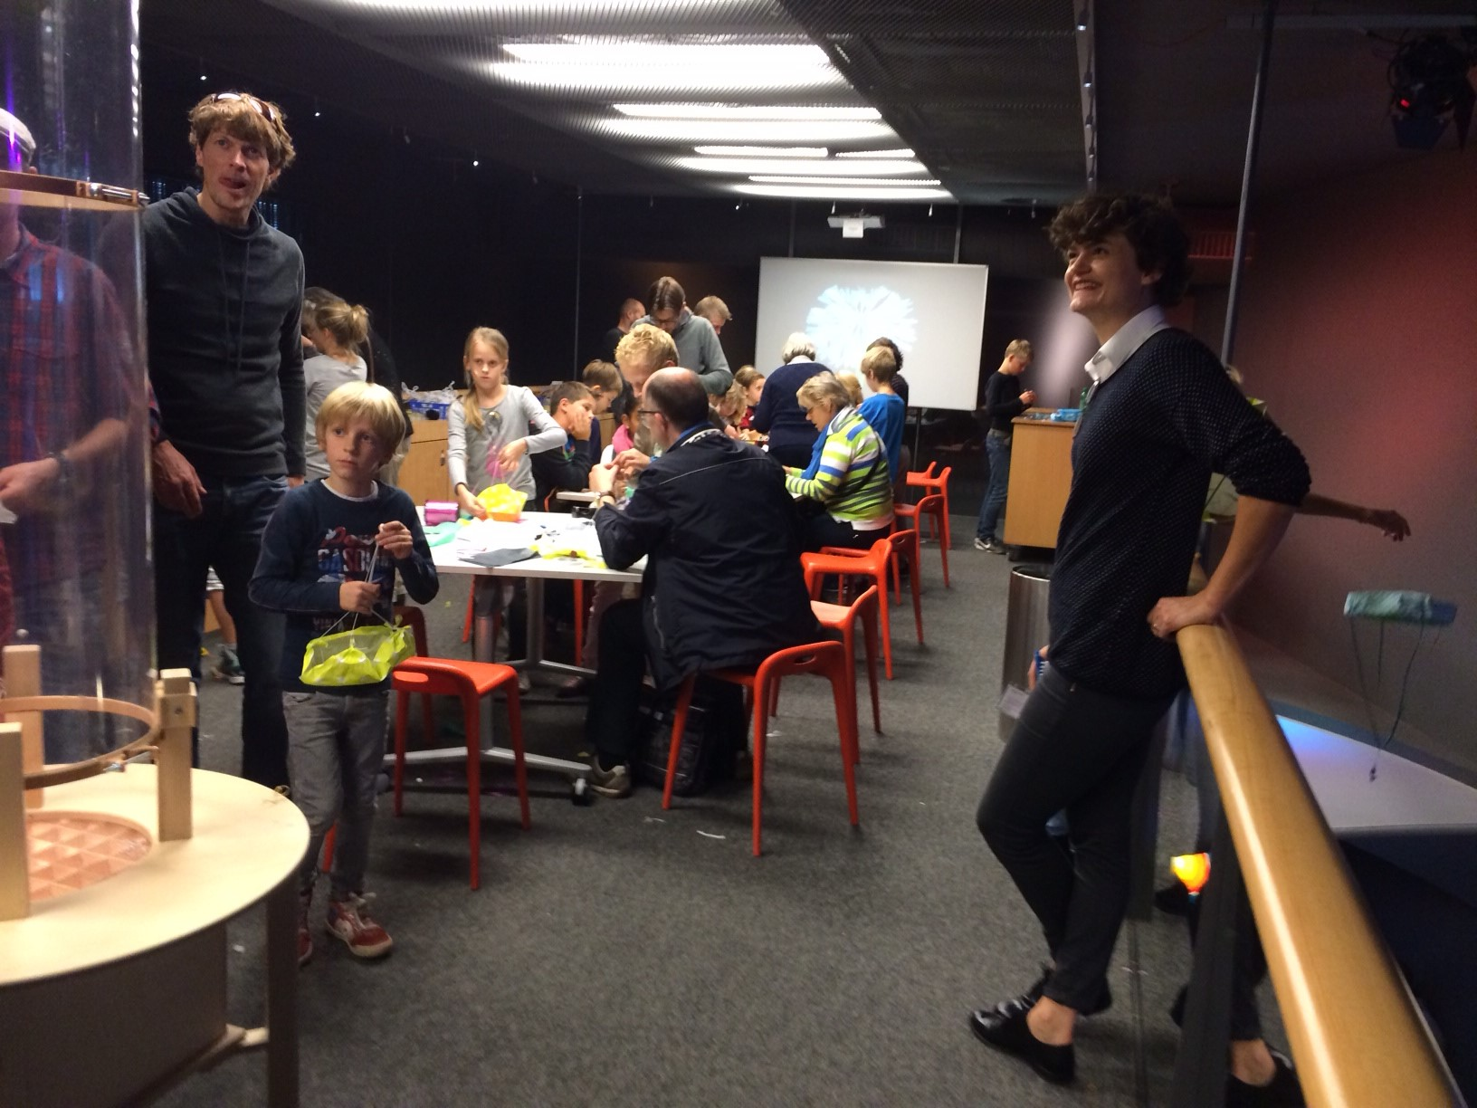
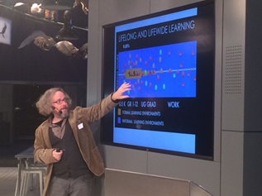
Educational scientists

Slide 14
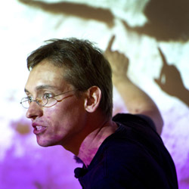
What scientists say
Why do they participate?
“Duty to society as a museum scientist”
“Make people as enthusiastic as I am”
“Fun and enriching”
“it generates possibilities”
What have they learned?
“Keeps me grounded”
“Keeps me from losing myself in details”
“Be clear about your goals and wishes”
“be careful not spend all my time, because it is so much fun”

Slide 15
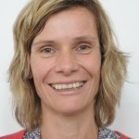
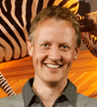
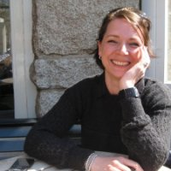
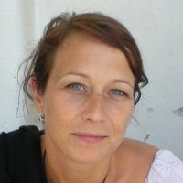
Lessons learnt
Just like normal people
Majority enthusiastic, involve them
Enthusiasm can take time
Active participation is preferred
Take time to keep them involved
Beneficial both ways
Time perceived as constraint
Assist with selecting information

Slide 16
Conclusions
Mutually beneficial
All involved (should be) curious and enthusiastic
Learn from each other
Don’t rush, take time

Slide 17
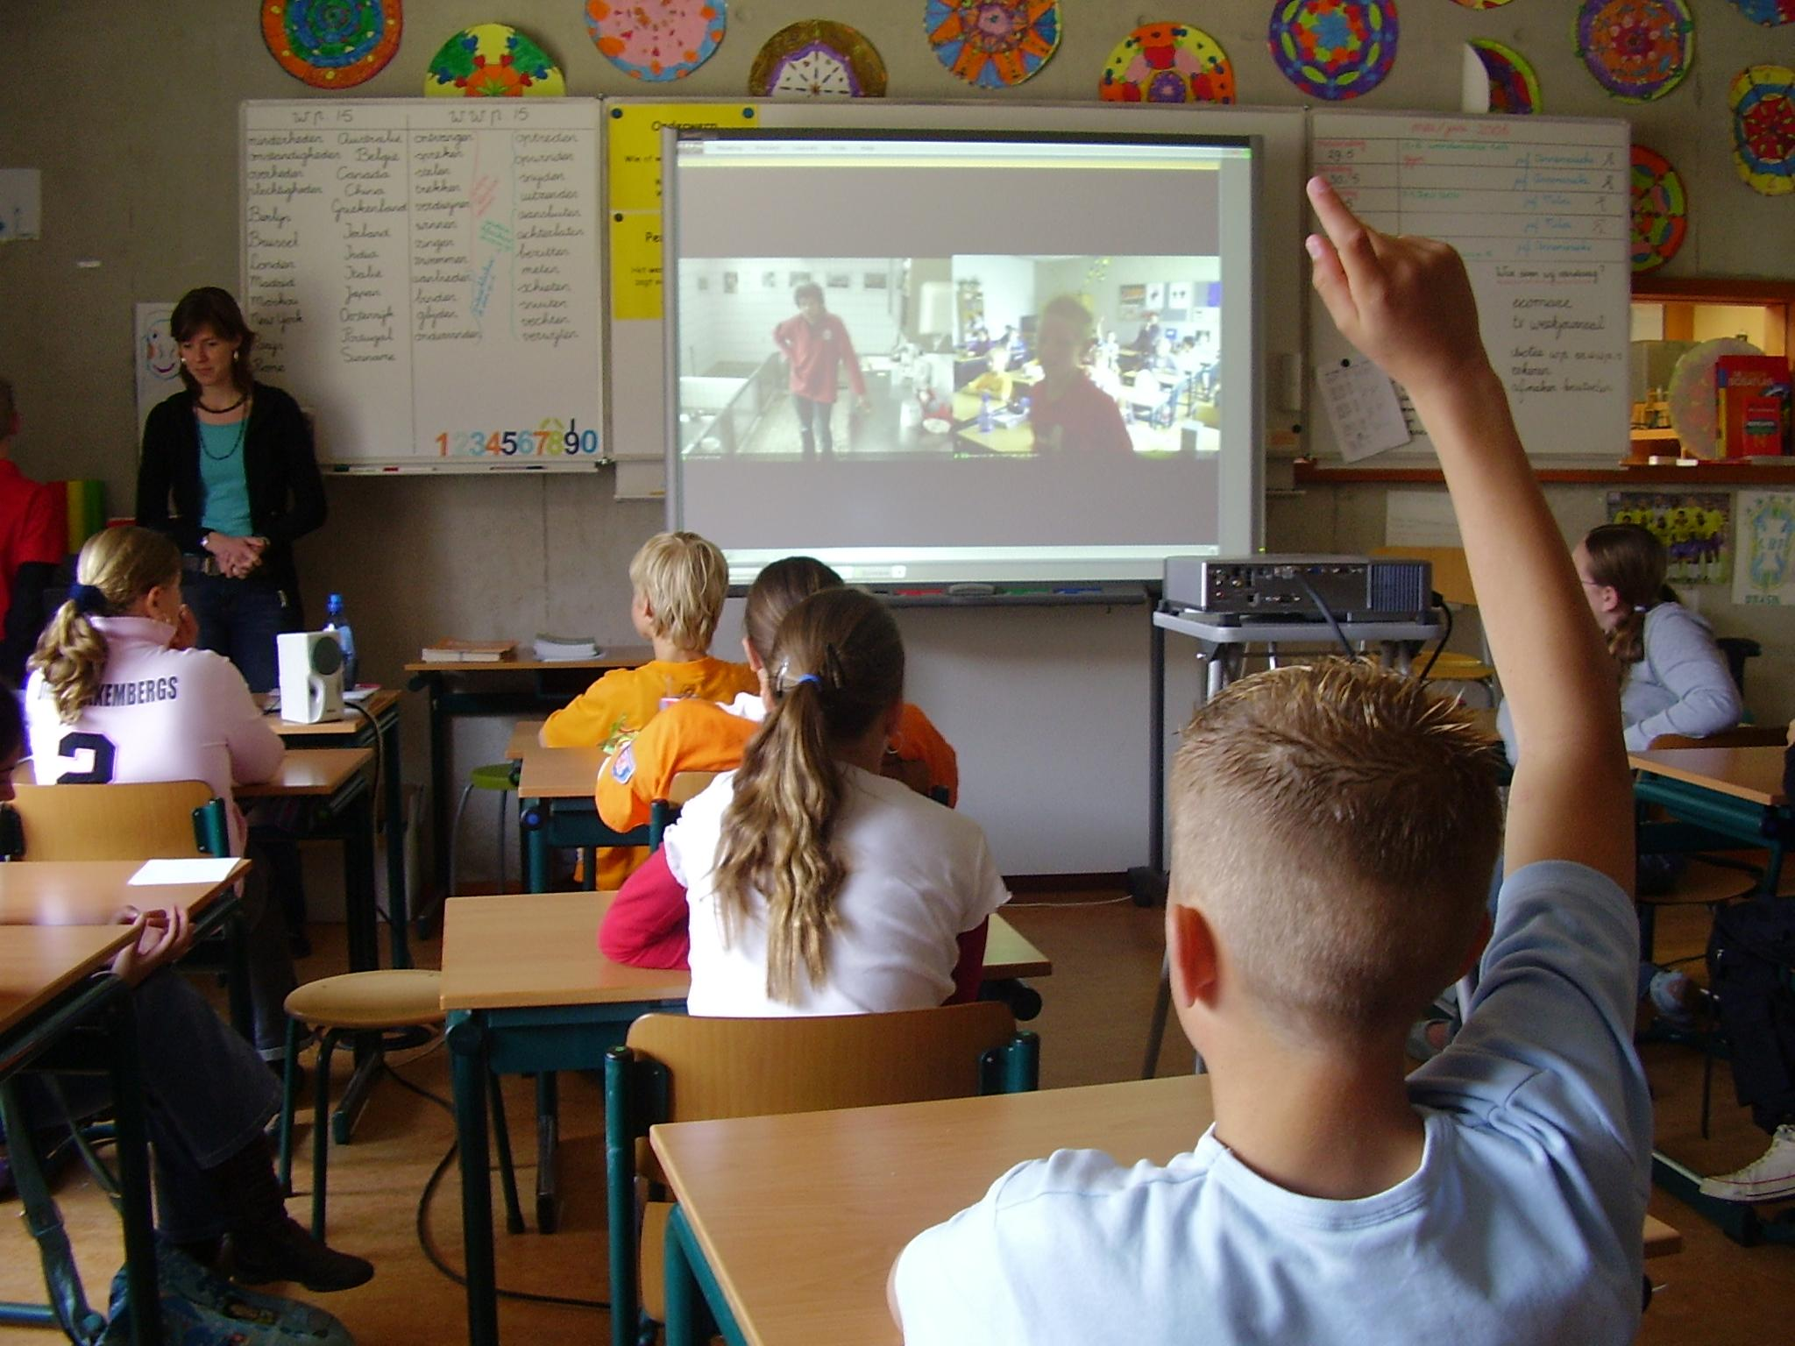
Discussie
Questions
yuri.matteman@naturalis.nl

Slide 18
Re-thinking collaboration with scientists Thank you for your attention

