Slide 1
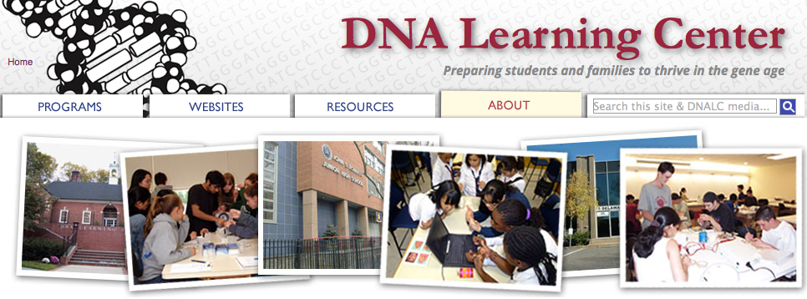
Citizen Science Infrastructure at the DNA Learning Center
Christine Marizzi, PhD
DNA Barcoding Programs Manager
Cold Spring Harbor Laboratory
ECSITE pre-conference workshop, 2016
cmarizzi@cshl.edu @cmarizzi

Slide 2
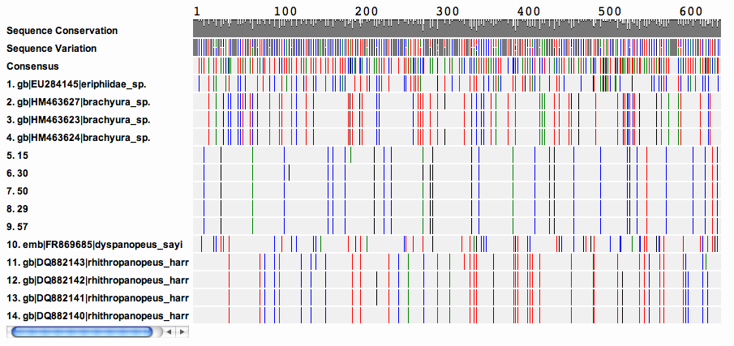
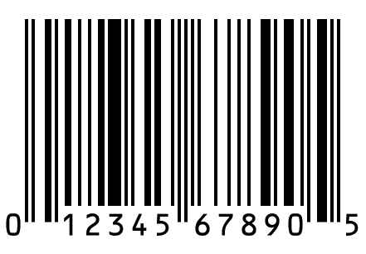
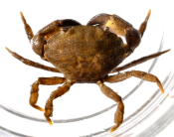
DNA Barcoding Programs
Just as the unique pattern of bars in a universal product code (UPC) identifies each consumer product, a short “DNA barcode” (about 600 nucleotides in length) is a unique pattern of DNA sequence that can potentially identify each species.

Slide 3
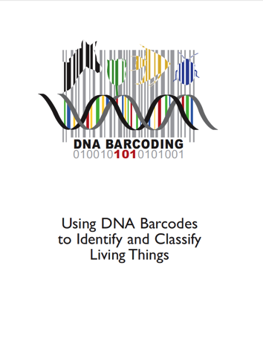
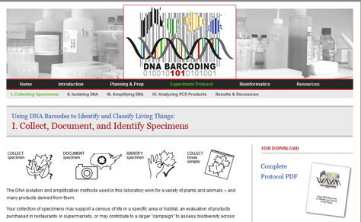
DNA extraction
and PCR
Import
sequences
Assemble
sequences
Add additional
sequences
Sequence
Analyze
sequences
Collect
samples
Export
sequences
Wet-lab
www.urbanbarcodeproject.org
www.dnabarcoding101.org

Slide 4
DNA extraction
and PCR
Import
sequences
Assemble
sequences
Add additional
sequences
Analyze
sequences
Sequence
Collect
samples
Export
sequences
Bioinformatics
Ride!

Slide 5
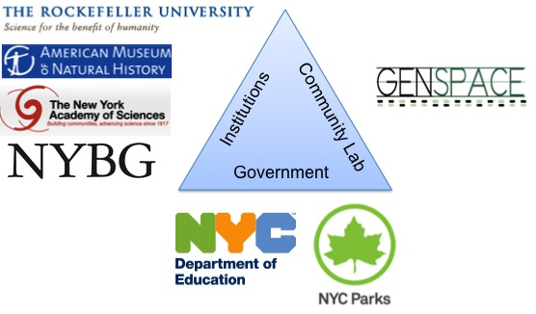
DNA Barcoding Programs:
Our collaborators

Slide 6
2012-16 DNA Barcoding Programs
873 Students
First research experience for most
>30% underrepresented minorities in science
345 Teams
212 Mentors from 159 Institutions
5 NYC Boroughs
5,800 samples processed
9,900 barcode sequence reads, > 2,6 Million Next Generation Sequencing reads
125 novel barcode sequences published at GenBank
several publications in high-impact journals with student's contribution

Slide 7
Evaluation (Attitude changed)
SURE-III: High school DNA barcoding research has
similar impacts as undergraduate research

Slide 8
DNALC Exit Survey 2012-2015 (conceptional)

