Slide 1
wow-effect  real science
Manuela Ringbauer
Junior Project Manager at Vienna Open Lab
Contact: ringbauer@viennaopenlab.at

Slide 2
Our aim - “real science“ for the public
LOCATION
show where scientists work
19 different hands-on laboratory workshops
close proximity to research
CONTENT
show what scientists do
provoke enthusiasm for science
LAB SETTING
show how scientists work
illustrate career pathways
HEUREKA
moment
TUTORS
show who scientists are

Slide 3
Teachers’ expectations
...that there is a connection to reality, to the day to day business in research and that the students can see the setting for themselves.
close proximity to research
Students can see the practical applications of what they already know from their school books...
Getting to know laboratory work ... so that students know, if that might be a possible career pathway for them.
...that they understand the bigger picture and their basic knowledge is given more meaning.
Source: structured interviews, ViOLab 2013

Slide 4
Individual visitors are different...
currently
narrow age groups
parents are a distraction
demand
less theory
more experiments
kids + parents
Challenges
parents take an active part
content for broad age group
more experiments
educational aspect?
→ Different concept needed?

Slide 5
New approach – “Halloween special“ for families
self-guided experiments
parents as “facilitators“
open inquiry
flip-cards with research questions & tips
open outcome
“wow“-feeling when accomplishing an experiment together
intentional use of “wow-effects”
demo
experiment

Slide 6
New approach – “Halloween special“ for families
self-guided experiments
“less is more”
parents as “facilitators“
stressful for parents
open inquiry
experiments worked
flip-cards with research questions & tips
evaluation required! were flip-cards helpful?
open outcome
curiosity-driven exploration?
“wow“-feeling when accomplishing an experiment together
evaluation required! remember WOW or HOW?
intentional use of “wow-effects”
great feedback visited again
asked for more family programs
demo
experiment
fun

Slide 7
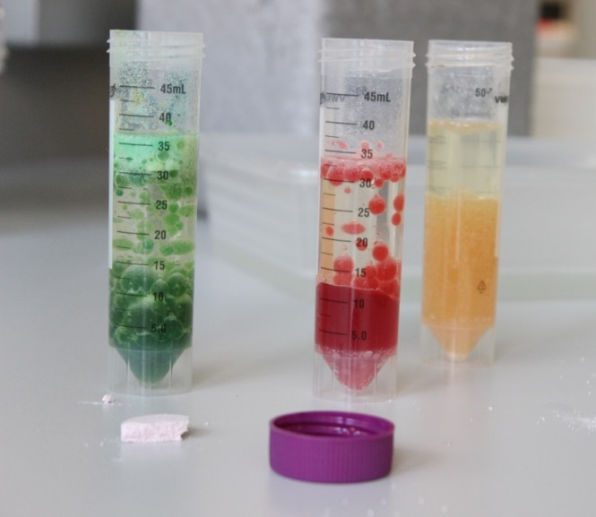
Remember the WOW or the HOW?
HOW do you think the colourful bubbles are formed?
Quiz

Slide 8
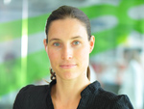
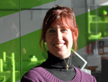
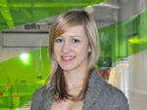
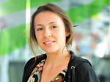
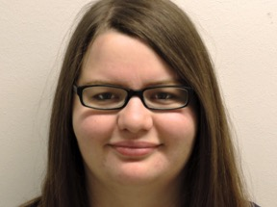
The Vienna Open Lab Team
Karin Garber
Managing Director
Melanie Konegger
Assistant
Manuela Ringbauer
Junior Project Manager
Silke Seidinger
Technician
Sabine Lasinger
Training for Tutors
Tutors
Pool of 35 independent contractors
Foto credits (slides 2, 3, 5, 6): Philipp Hartberger © Vienna Open Lab

Slide 9
Financiers
Federal Minister of Science, Research & Economy
City of Vienna
Federal Ministry of Education & Women's Affairs

