Slide 1
Race, science & authority
Phil Loring (@ph_lor)
Curator of the History of Medicine
Norsk Teknisk Museum
Ecsite annual conference
11 June 2016
#ecsite2016 #gallBC

Slide 2
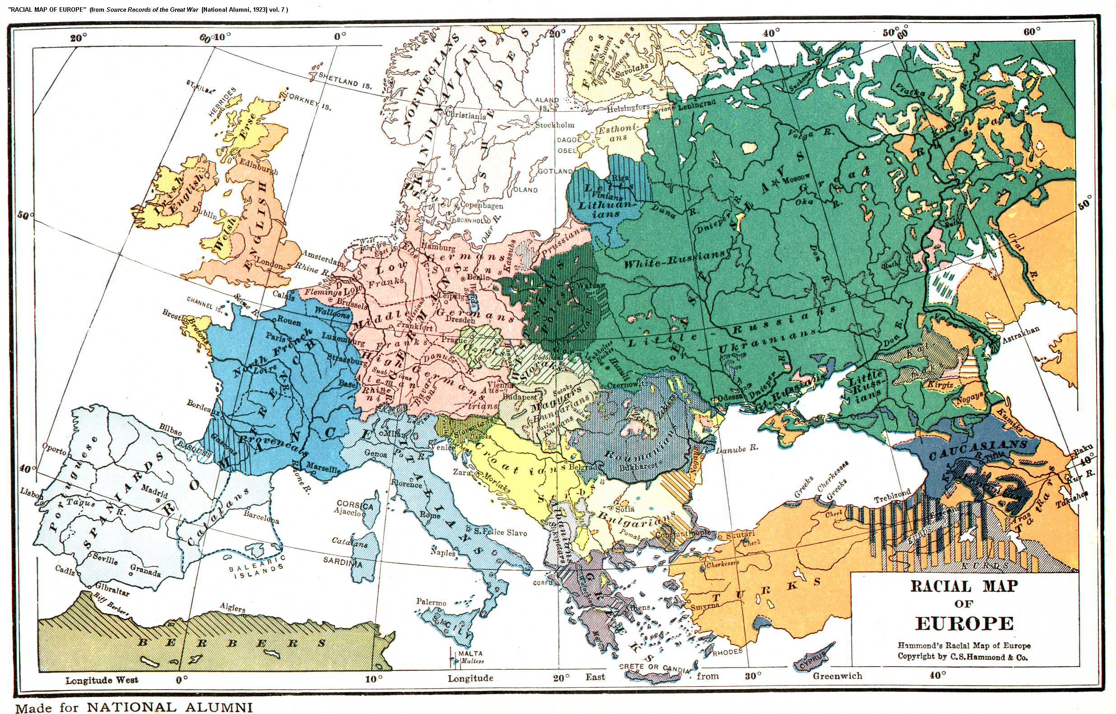

Slide 3
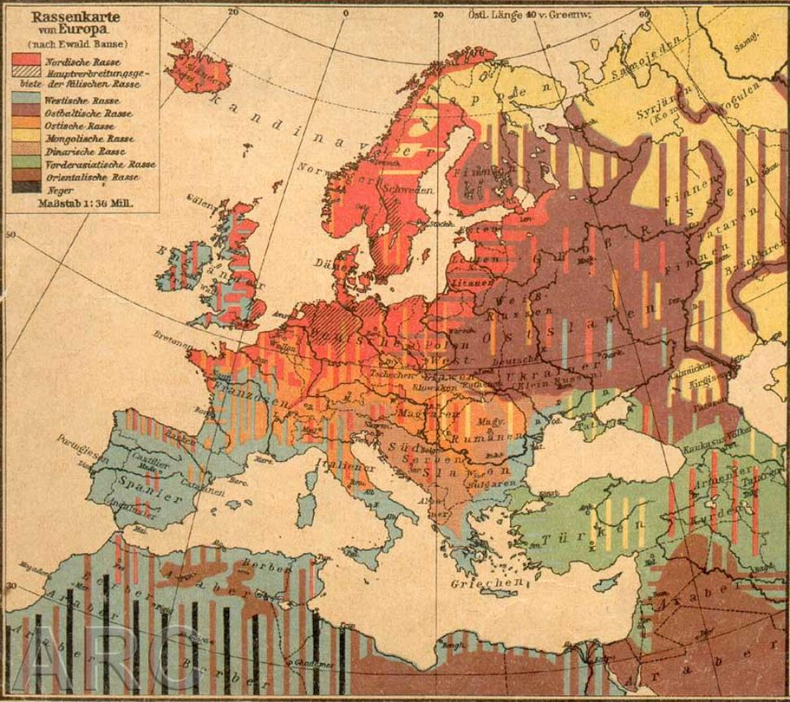

Slide 4
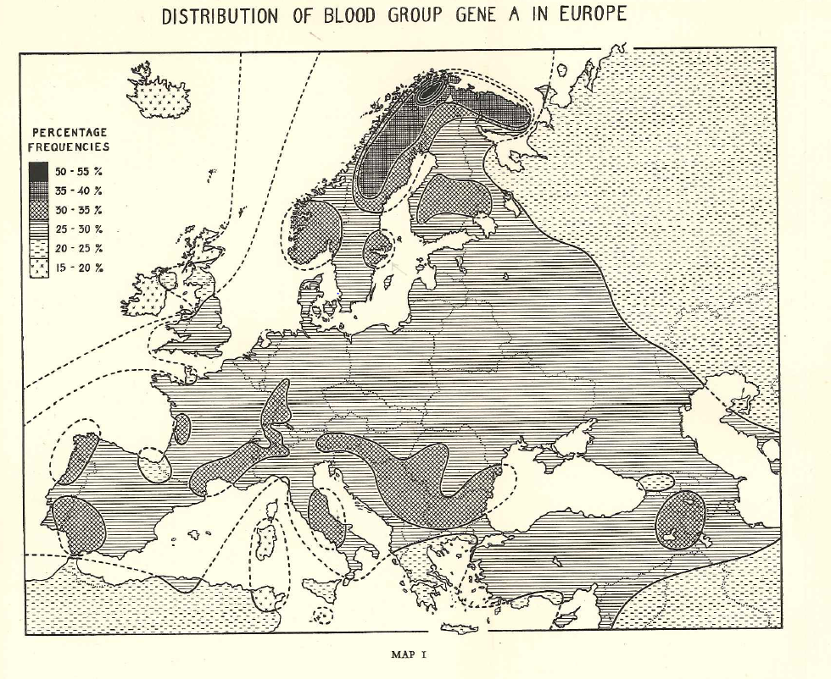

Slide 5
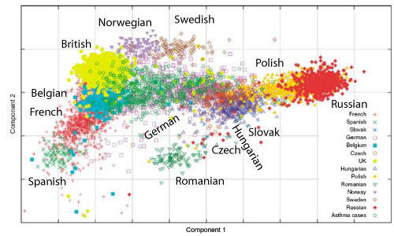

Slide 7
Why work with 2nd-generation migrants on an exhibition about the science of human genetics?
A step towards a more inclusive, diverse, accessible museum
Redistributing authority, both in science and in culture
A better, more engaging exhibition

Slide 8
Thank you!
Phil Loring (@ph_lor)
Curator of the History of Medicine
Norsk Teknisk Museum
Ecsite annual conference
11 June 2016
#ecsite2016 #gallBC

