Slide 1


International Staff Development
By: Sawsan Dalaq
Director, The Children’s Museum Jordan
&
President, NAMES (North Africa & the Middle East Science Centers Network)
sawsan.dalaq@cmj.jo

Slide 2

The Situation
locally
We are more than a children’s museum
Hit by Crisis: no budget
Jordanians are too serious!
This is not a profession
An emerging field: no one to learn from

Slide 3
The Situation
regionally
Publicly run centers ( not always good)
Some of the local issues (but of course!)

Slide 4

Solutions (or at least some…)

Slide 5
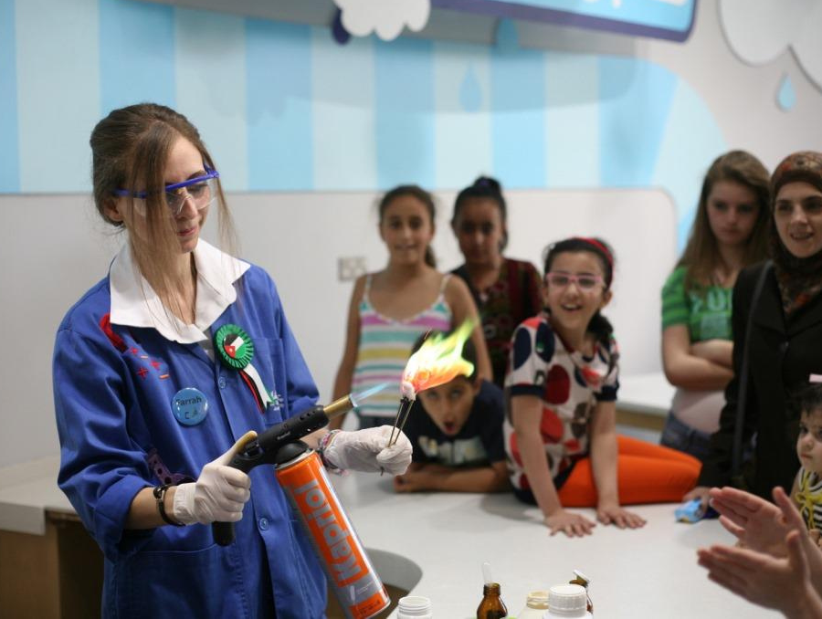
Bring back the value and respect:
salaries when possible yes, but also job prominence

Slide 6
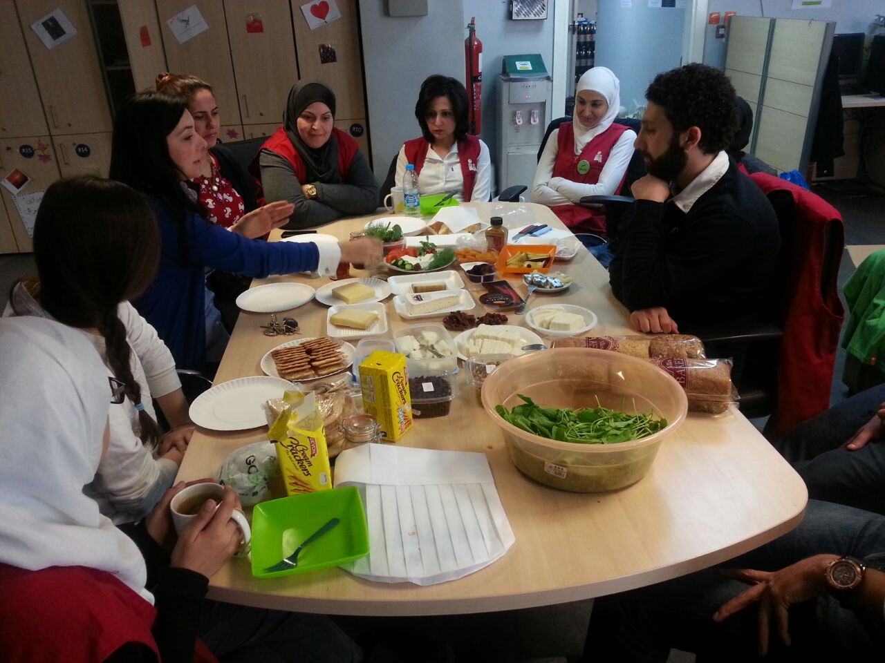
Internships
Sharing information
Trial and error

Slide 7
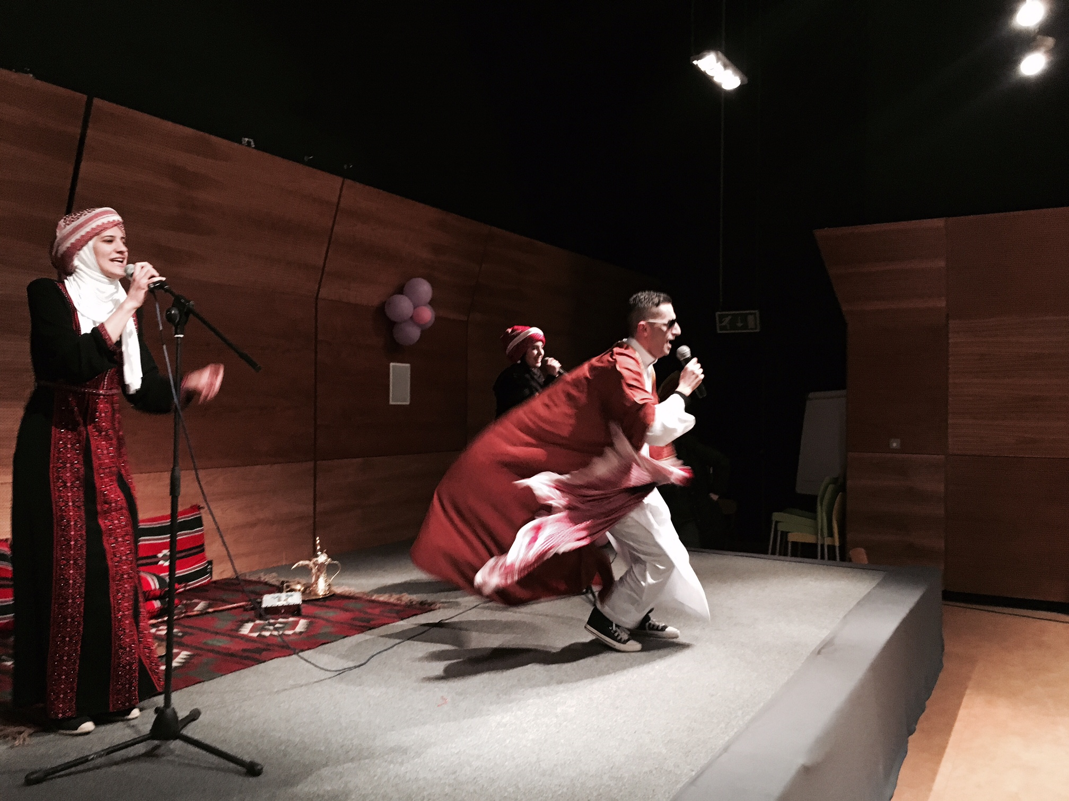
A little of the unusual but fun!
Sing-along to learn English
Role play
Creativity

Slide 8
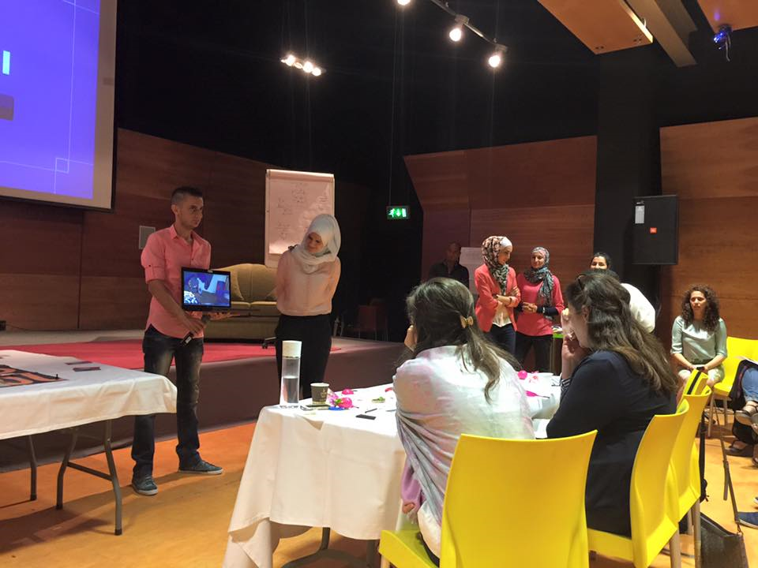
The Weirdest Link
Workshops
Design
Presentation & judging

Slide 9
Clubs
Health club, invention club, art appreciation club, flavors and food club
Exchange
An exchange program with Mishkat
Projects
A science investigation to answer questions like: can we travel in space?; Write a short story, make a painting based on an art school, make an automata machine, etc.…

Slide 10
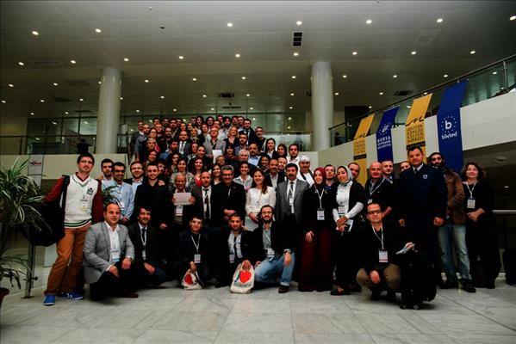
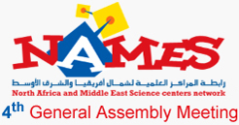

Slide 11
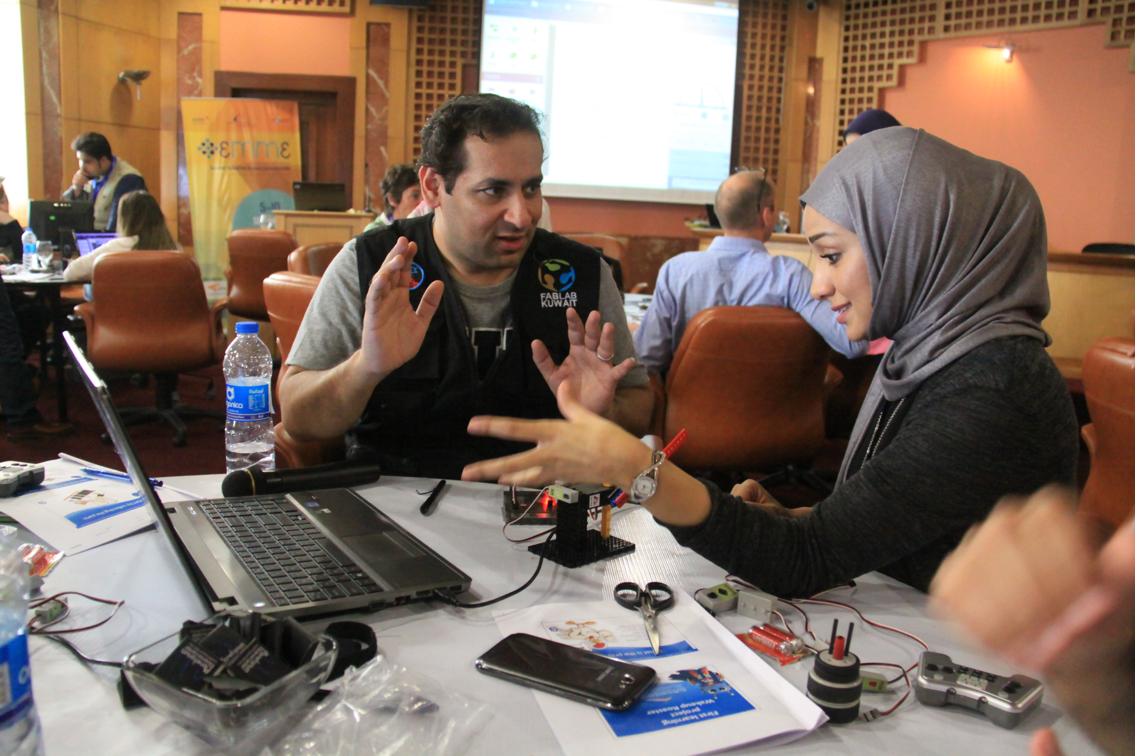
NAMES/Ecsite partnership: the EMME Summer School

Slide 12
Internationally - the best are:
Partnerships & Exchange
More like EMME
Cross regional capacity building

Slide 13
In summary:
@ The Children’s Museum Jordan
Value the facilitators
Stay open minded
Experiment and keep trying
@ NAMES
Build on positive models
Start dialogue across borders
Experiment and keep trying

Slide 14
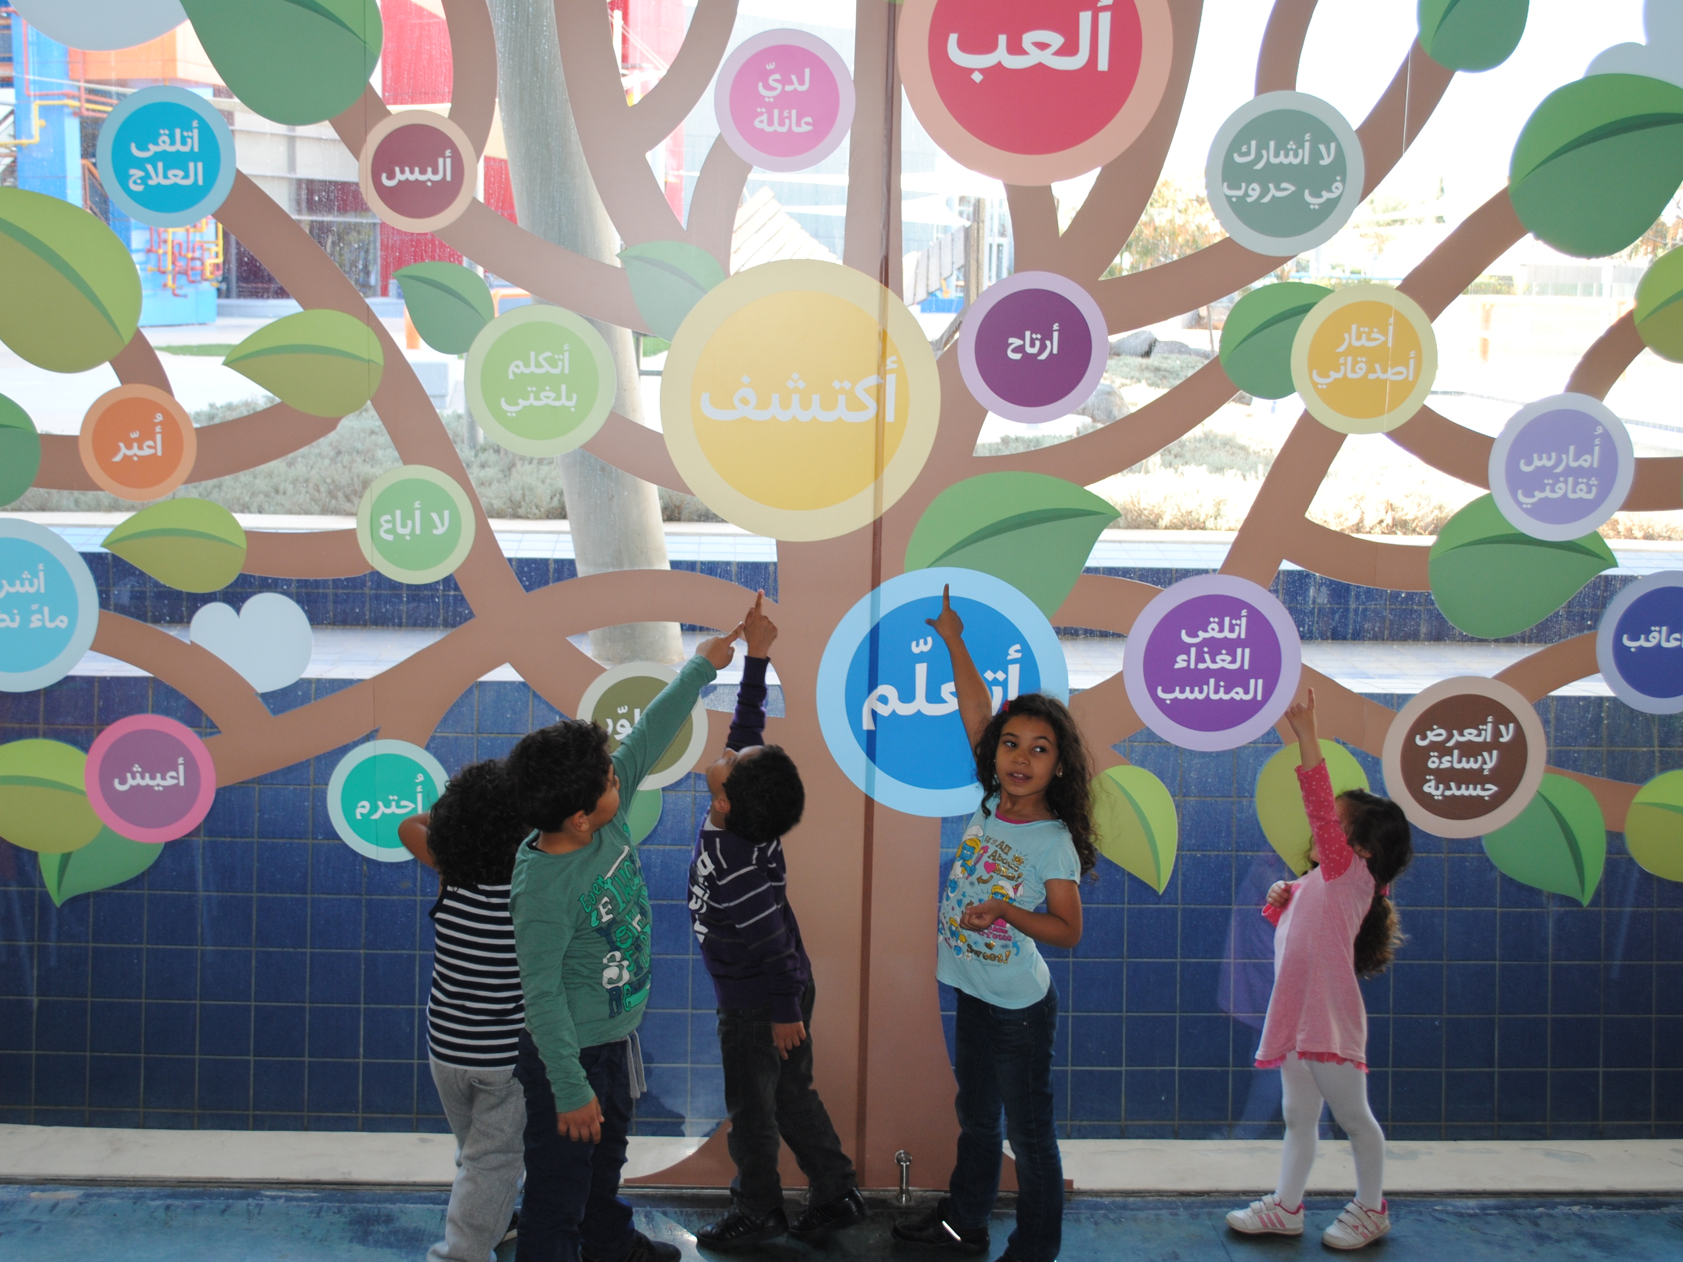
Future plans:
  Our Strategic Objectives 2015-2017
  Increase awareness of the Children’s Museum Jordan and make the Museum’s experience more accessible both nationally and regionally
  Make the Museum a flagship for innovation
  Intensify and focus on the Museum’s initiatives that support Early Childhood Development
  Thank you…

