Slide 1
Integrating research into exhibition development
Towards a model for a research based exhibition design processes.
Notes:
This work is a continuation of the research activities in pulse, and we aim to visualize an overall model of the possibilities and challenges connected to the meeting between research and exhibition development. And trying to give an overall view and visualize what we have learned in the process.

Slide 2
Exhibition development as a very complex process of creating a communication and educational product.
- Scientific correctness vs. Research based design choices (very roughly put)
Content/theme
It is one thing to check if the information/theme you want to convey is up to date
→ E.g. talking to brain specialists about the newest scientific discoveries when producing an exhibit about the brain.
Format/form/design choises
It is another thing to actively use theories and user driven methods in the development of an exhibition design.
→ E.g. PULSE is based on well-defined, instructional concepts, such as a participatory approach, involving users as active agents and a positive, broad perception of health.
During the past few decades, museums and science centres throughout the world have placed increasing emphasis on their educational function. Although exhibitions are the primary means of promoting visitors’ learning, educational research is not often utilised when designing these learning environments. Rather, the development of exhibitions in museums and science centres tends to rely on the know-how of the staff (Laherto, 2013: 121)
Notes:
Like they said in the session about re-thinking collaboration with scientists. Its about what kind of conversations that is initiated an facilitated between researchers and SC.
What we wanted to emphasize – format/design choices

Slide 3
Making a model from a DBR framework in the Science Centre context
What did we learn?
There is a need for communication strategies when research and development meet.
The exhibition is not the sole ‘production’ outcome of such a project, research papers and referable knowledge is also a core ‘product’.
The form of the research paper, report and so forth needs a forum for channelling and discussing the knowledge gained.
The level of collaboration between researchers and developers shifts during the project.
Data collected needs to both answer questions directly applicable for the development of the exhibition and work as data material usable for exploring bigger research questions.
Notes:
Making a model from a DBR framework in the Science Centre context
What did we learn?
There is a need for communication strategies when research and development meet.
The exhibition is not the sole ‘production’ outcome of such a project, research papers and referable knowledge is also a core ‘product’.
The form of the classical research paper, report and so forth needs a forum for channelling and discussing the knowledge gained.
The level of collaboration between researchers and developers shifts during the project.
Data collected needs to both answer questions directly applicable for the development of the exhibition and work as data material usable for bigger research questions.
Eg do we need to make this handle bigger before they pull it. And in what kind of way does the handle support which learning outcomes.

Slide 4
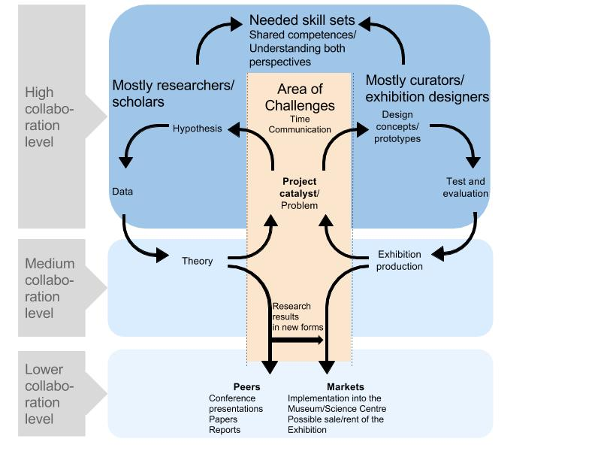
Making a model from a DBR framework in the Science Centre context
Research Based Exhibitions are often large scale, time demanding and involves one or more researchers
Project catalyst/Problem: How was the project initiated. Are the big questions asked and are decisions argued and written down? (Hauser, Noschka-Ross & Zahn, 2009)
Different collaboration levels when going from conceptual work and data work to the more ‘practical’ work eg. Exhibition production and paper production.
Area of challenges – “two worlds that collide”
(Zachariassen, Magnussen & Thiel, in prep.)
Notes:
Making a model from a DBR framework in the Science Centre context
(Hauser, Noschka-Ross & Zahn, 2009)
Brief walk through of the model
Right side mimics typical production circle of an exhibition and left side mimics a typical educational research project.

Slide 5
Has potential, but requires a different way of working – e.g. more use of theory in the development process
Different time perspectives
Better product
The relevance of the research appears so late that I do not have time to use it
Developers do not have the time to read the theory and methods themselves
If I say:
”Collaboration between exhibition developers and researches”
– What do you say?
Different worlds
Learns something new
Rarely includes challenging results (that could teach you something new)
Useful results occur to late in the development process
Challenging
Help for extraction of points to use in other contexts
Thoroughness
Important to make research generally applicable to more than the specific case
Shared knowledge generation
Notes:
Area of challenges – the same articulations is seen in litterature studies of other DBR projects in the museum and SC context.

Slide 6
Making a model from a DBR framework in the Science Centre context
Example – the project catalyst in PULSE.
Application is written in close collaboration between researchers from STENO healthcare and developers from Experimentarium. The initial hypothesis (positive health, co-creation) feeds into the design concepts and prototypes.
The evaluation is gathering data about the users everyday health habits that is used in the activities created for the exhibition. This data is also used by e.g. Ph.D. students in their academic work.
Developers and researches both worked on the planning and gathering of data.
(Zachariassen, Magnussen & Thiel, in prep.)
Notes:
Making a model from a DBR framework in the Science Centre context
Developers hold valuable knowledge such as of the many aspects of creating an exhibition
Researches hold valuable skills such as data gathering methods, researching relevant knowledge
It is important that both have an understanding and appreciation of the research and development process and skills involved and needed.

Slide 7
Making a model from a DBR framework in the Science Centre context
Example – the Exhibition and theory production in PULSE
The researchers and developers are now more focused on creating the exhibition and following interesting analysis possibilities. At this point more could have been done to secure dialogue and the use of different skills.
If research results are to have impact on the design they have to be presented in other forms than finished papers
“I can just remember some of the first meetings where we talked schedules and so one of the researchers start by saying 'that we must just make a research protocol and it takes half a year and then we just …: what? We need the data NOW! (...) It was two worlds that met with a smack.”
- Pulse-project participent
(Zachariassen, Magnussen & Thiel, in prep.)
Notes:
Making a model from a DBR framework in the Science Centre context
Challenges also being different time momentums.

Slide 8
Making a model from a DBR framework in the Science Centre context
Is it just a paper for the shelf?
Example – the re-design iteration of the PULSE-exhibition.
Data gathering in the finished exhibition
The research activities are able to refer to the more overall tendencies articulated in an evaluation report.
→ Papers created in PULSE should be able to guide and help other health promoting exhibition initiatives on a more general level.
→ The evaluation report is solely relevant for the specific exhibition and organization.
A goal of the project is also to develop this model and
this presentation is a part of the broader contribution to the field.
(Zachariassen, Magnussen & Thiel, in prep.)
Notes:
Both: An evaluation report (non-academic) is created to answer overall questions such as the popularity of the exhibition and audience responses to the entertainment and educational value of the exhibition. This is mostly based on quantitative data.
And research questions are explored for further publications asking in depth questions such as what knowledge types does the visitors achieve in which parts of the exhibition?
The findings leading up to the model, and the use and possibilities of the model are planed to be presented in different forums in the organisation.

Slide 9
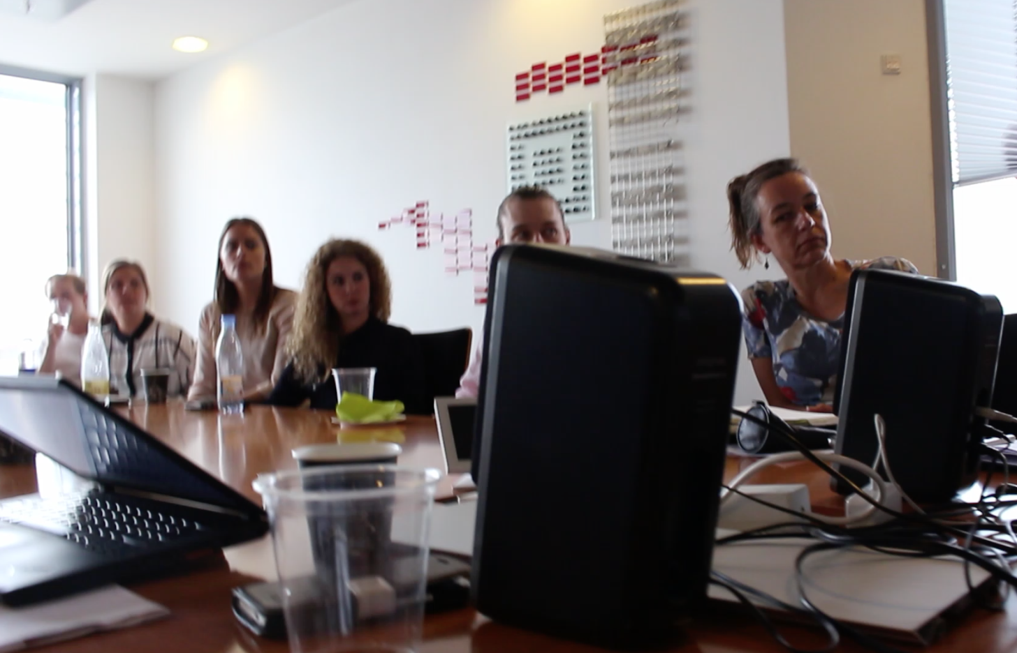
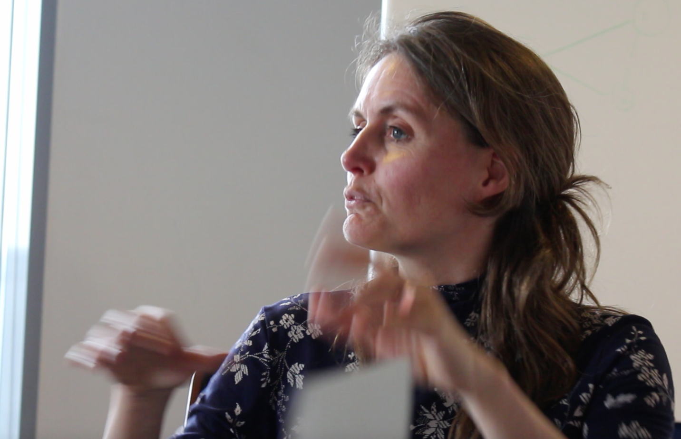
Making a model from a DBR framework in the Science Centre context
Is it just a paper for the shelf?
Example – the re-design iteration of the PULSE-exhibition.
Example of knowledge sharing of research activities in a new form. A seminar with short presentations and room for discussion.
Yes that is mighty interesting, what do you think about…
(Zachariassen, Magnussen & Thiel, in prep.)
So we can se that..
Notes:
No finished and published papers yet, but the data was collected and almost analysed. People not directly involved in the pulse project where there too, to learn about the findings. It included presentations from master students too.
The developers now have a collected picture of the knowledge building in the exhibition.
The presentations focused on what the study was concerned with and how the findings could have an impact on the re-design of the exhibition.

Slide 10
Thank you for listening!

Slide 11
References Barab, s., & Squire, K. (2004). Design-based research: Putting a stake in the ground. The journal of the learning scinences, 13(7), s. 1-14. Cobb, P., Confrey, J., Lehrer, R., & Schauble, L. (2003). Design experiments in educational research. Educational researcher, 31(1), s. 9-13. Ejersbo, L. R., Engelhardt, R., Frølunde, L., Magnussen, R., & Misfeldt, M. (2008). Balancing product design and theoretical insights. I A. E. Kelly, R. A. Lesh, & J. Y. Baek, The handbook of design research methods in education: Innovations in science, technology, engineering and Laherto, A. (2013). Informing the development of science exhibitions through educational research. International Journal of Science Education, Part B, 3(2), s. 121-143. Reisman, M. (2008). Using Design-Based Research in Informal Enviornments. The Journal of Museum Education, 33(2), s. 175-185. Walter, H., Noschka-Roos, A., & Reussne, E. (13. October 2009). Design-Based Research on Digital Media in a Museum Environment. Visitor Studies, 12(2), s. 182-198. Zachariassen, M., Magnussen, R. & Thiel, S, C. (2016) Towards a model for Research-based Exhibition Development using Design-based research as a framework, In preparation.

Slide 12
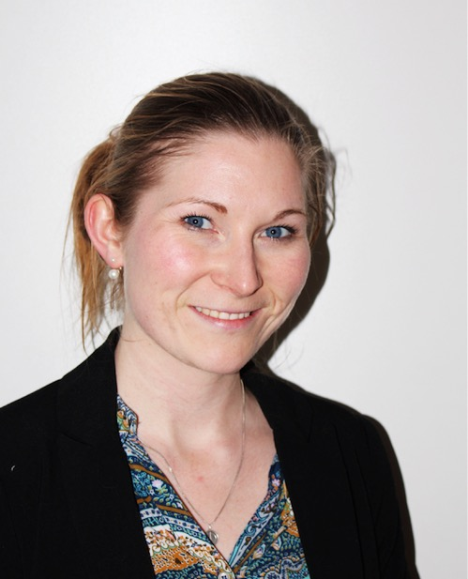
Who am I?
Maria Zachariassen
Research and Development Assistent
Experimentarium
mariaz@experimentarium.dk
marzach87@hotmail.com (after august 2016)
+45 30645825
Denmark

