Slide 1
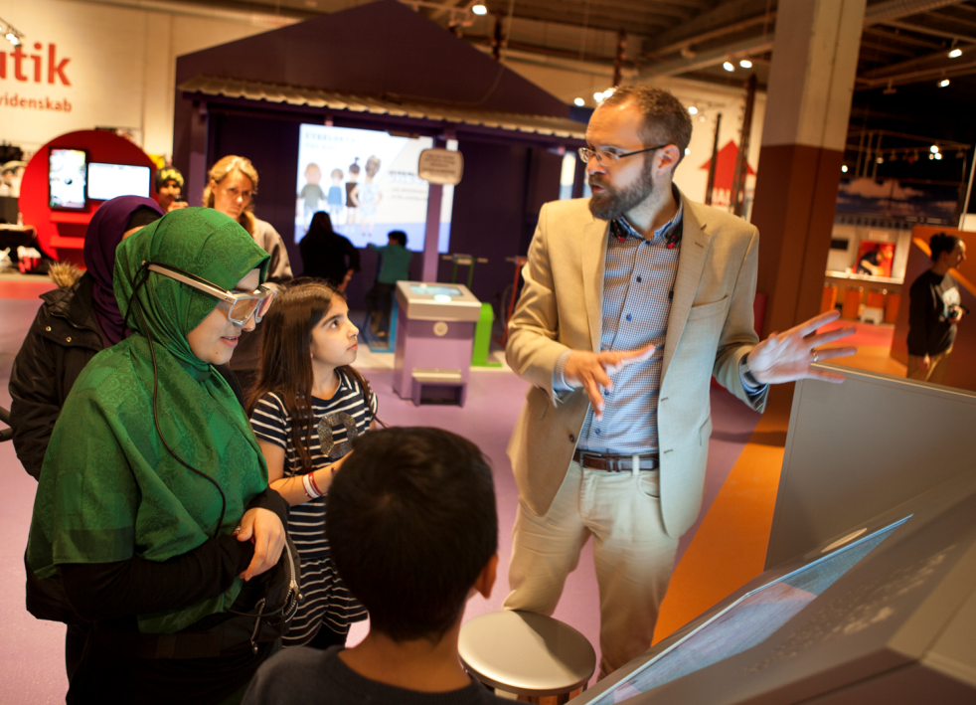
Letting researchers into the exhibition
PULSE: Towards a model for research-based exhibition development

Slide 2
Has potential, but requires a different way of working – e.g. more use of theory in the development process
Different time perspectives
Better product
The relevance of the research appears so late that I do not have time to use it
Developers do not have the time to read the theory and methods themselves
If I say:
”Collaboration between exhibition developers and researches”
– What do you say?
Different worlds
Learns something new
Rarely includes challenging results (that could teach you something new)
Useful results occur to late in the development process
Challenging
Help for extraction of points to use in other contexts
Thoroughness
Important to make research generally applicable to more than the specific case
Shared knowledge generation
Notes:
Asking the Development Department at a meeting to do a quik brainstorm
Answers from: Developers, project managers, designers, graphic designers, PhD-student

Slide 3
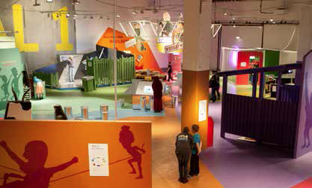
PULSE: Health promotion exhibition for families
    Health promotion exhibition: Families with children aged 6 – 12
    Collaboration between research and exhibition development. A model.
    ”What kind of educational and structural elements (designs) should be integrated in health exhibitions and associated community activities to encourage families to take action that improves and sustains their health?”
    Empowerment (Freire), Action competences (Bruun Jensen), Island of expertise – dialog and learning at science centers (Crowley)

Slide 4
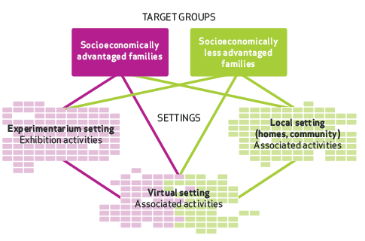
The PULSE project: Settings
Exhibition setting
Exhibition activities
Co-development with PULSE Families
Virtual setting
Mobilhund.dk, marketing activities,
PULSE site, personal homepage activities
Local setting
Network activities, X-Bus, Mobilhund.dk
Marketing events opening exhibition

Slide 5
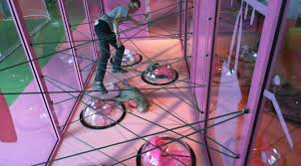
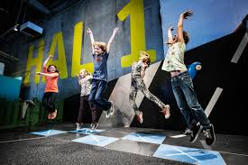
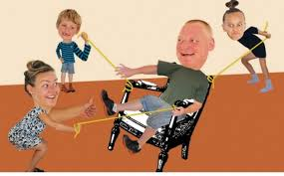
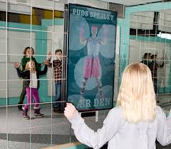
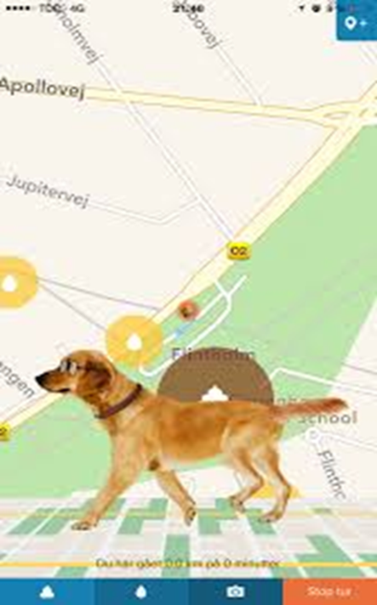
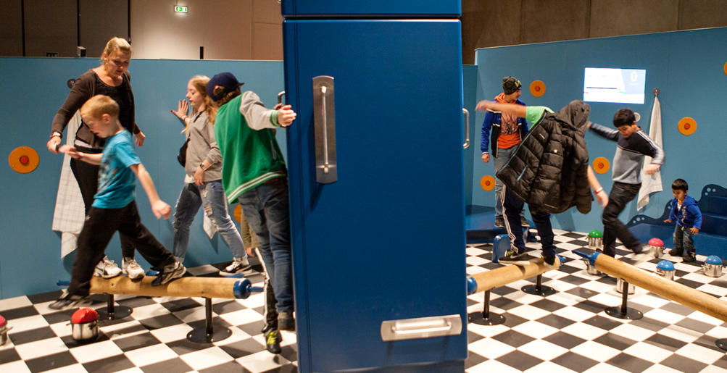
PULSE: The slightly screwed home

Slide 6
Evaluation and research goals
Success criteria – Evaluation
Participant time in exhibition
Scores audience satisfaction
Socio-economical background
Model for cross-disciplinary development of research-based exhibition practice at the Experimentarium
Goals developers – research
Inspiration, the family as an active, playful unit
New knowledge, movement, physical activity
Connection to everyday life, relevance to everyday life
The Family Experience, the family as a social group
The positive experience of movement/physical activity, to be challenged, to understand something new about yourself (Results from workshop with developers (Data: Thulstrup Jensen, 2014)

Slide 7
Method: Design-based research
DBR: Iterative cycles of problem definition, design, intervention, analysis, redesign…
Focus on theory-based design and design as part og research.
Both focus on developing new designs and generating research knowledge from designing
PULSE proces
Theory-building: E.g. Empowerment, Design: Pulse families, testing: audience

Slide 8
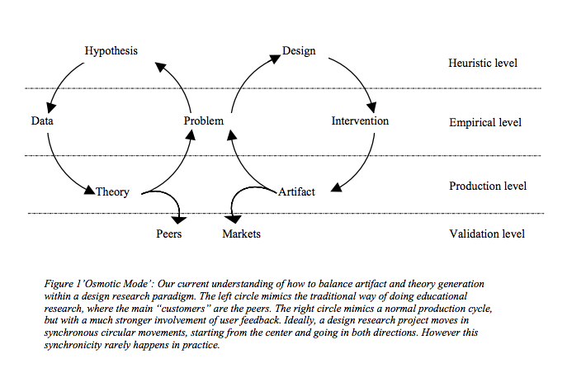
Balancing development and research

Slide 9
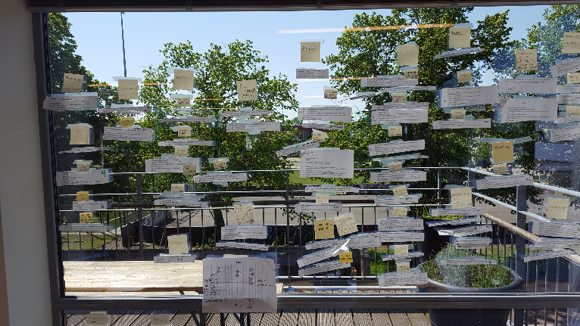

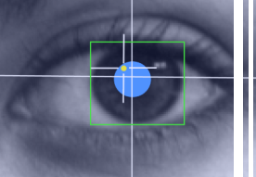
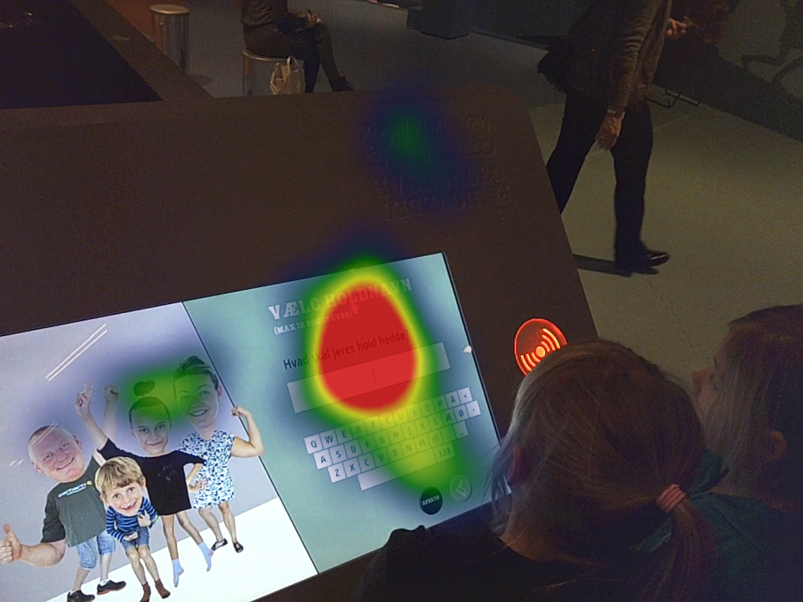
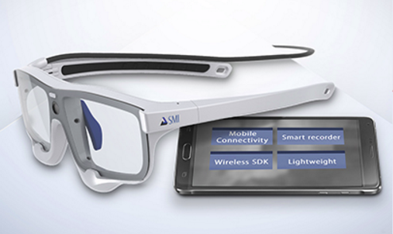
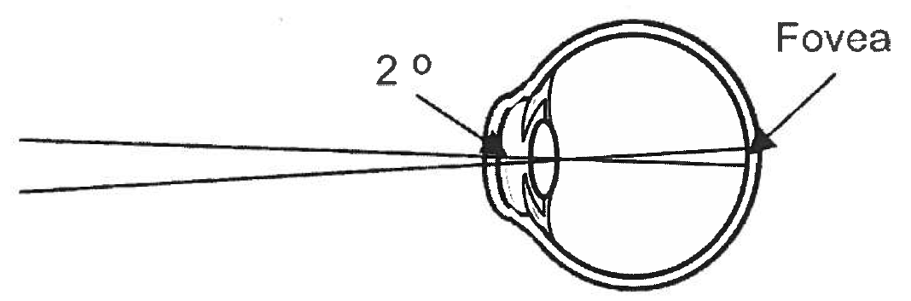
And then we started…

