Slide 1
Scientists – Communicators A Basis for Fruitful Cooperations
Brigitte Gschmeidler
ECSITE 2016, Graz
Notes:
I am going to present an example of how to institutionalise contacts between a science communication organisation and scientists to create a basis or to support fruitful cooperations.

Slide 2
About Open Science – Lebenswissenschaften im Dialog
Is a publicly funded non-profit organisation
Advocates the well-founded dialogue about life sciences
Performs various projects involving science communication
Operates the Vienna Open Lab – a molecular biology & chemistry hands-on laboratory
11 employees (~ 8 FTE)
Combines expertise in science, communication, and related areas
Association Open Science
Projects
Vienna Open Lab
Notes:
First, I will give you some information about our organisation because I think some aspects of our structure influenced and influence the model I want to show you.
Open Science is a publicly funded non-profit organisation with the aim to advocate the well-founded dialogue about life sciences. We perform various projects involving science communication – a lot with schools but also for adults – and we operate the Vienna Open Lab – a molecular biology and chemistry hands-on laboratory. We are a relatively small organisation – we have 11 employees, not all of us fulltime, so 8 full time equivalents. Our employees combine expertise in science, communication, and related areas.

Slide 3
Involvement
Scientific background of the employees
Eight Austrian scientific societies as member organisations
Executive board (4 members)
Board and Delegates
Located at the Campus Vienna Biocenter
close contact with researchers
Young Scientists as Tutors in the Vienna Open Lab
University lectures about science communication for scientists
Wide-ranging network of experts who are willing to support the activities
Notes:
Ho do we cooperate with scientists or involve scientific expertise in our work?
As I already said, one aspect is the scientific background of the employees.
Then, as we are an association (a Verein) we need to have members. And the members of our association are Austrian scientific societies – for example the AUSTRIAN ASSOCIATION OF MOLECULAR LIFE SCIENCES AND BIOTECHNOLOGY. They nominate members for our executive board and send delegates to the board.
So, we are deeply rooted in science
Further more we are located on a university campus which gives us the possibility for close contact with researchers. Our hands on lab is also located there in a research building. And we employ young scientists as tutors. After they have finished a university lectures about science communication they can work in our lab as tutors. Most of them do that besides their masters or doctoral studies.
And then we have a network of experts who are willing to support our activities.
Zoologisch-Botanische Gesellschaft Österreich; Österreichische Gesellschaft für Molekulare Biowissenschaften und Biotechnologie; Gesellschaft Österreichischer Chemiker; Österreichische Gesellschaft für Humangenetik; Österreichische Gesellschaft für Laboratoriumsmedizin und Klinische Chemie; Christian Doppler Forschungsgesellschaft
Christian Doppler Research Association promotes the cooperation between science and business

Slide 4
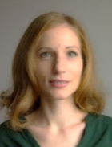
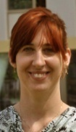
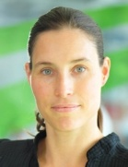
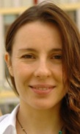
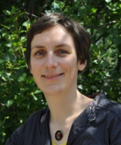
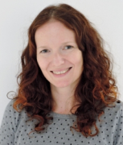
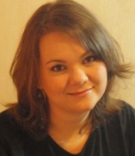
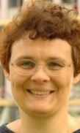
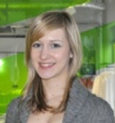
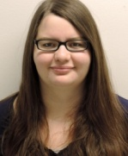
Board Members
Project Partners
Molecular biology
Social Sciences (STS)
Art, Visualization
Genetics
Biology
Science Communication
Science Journalism
Public Health
Microbiology
Expert-Database
Networks
Informal Contacts
Notes:
So, we have quite good access to scientific knowledge: in the team, via networks, personal contacts, at the campus – but in order to systemize and institutionalise these contacts we established an expert-database.

Slide 5
Expert-Database
Database of Scientists/Experts who are willing to
Support us in our work (review texts, answer questions,…)
Engage in science communication events and projects
Answer questions from journalists, students, teachers,…
On a voluntary basis
151 Scientists (life sciences, ethics, legal aspects, social sciences)
Notes:
We sometimes need experts to double check our website texts, or answer questions from high-school students who send us their questions, or we need specific expertise for a project … That is why we established a database ouf scientists who are willing to support us and our work. They have to fill in a form, answer some questions about their fields of expertise and state whether we are allowed to give their contact details to third parties (for example students or journalists). With their signature they state that they support public engagment activities.
Normally this is on a voluntary basis, if it is not a more extensive collaboration with specific funding.
At the moment we have 151 experts listed from the fields of life sciences, ethics, legal aspects, social sciences.
Reward: The pleasure to engage with the public, to work with young people, fun to communicate science

Slide 6
Positive elements and potential for improvement
Current status
Potential for improvement
For Open Science
Easy access to scientific expertise
„Broad detailed knowledge“
Access to people who are willing to engage with the public
Access to information within the team and securing knowledge
For Scientists
Possibility to engage in PE activities / ideas for engagement
Support from communicators
Possibility for additional funding
Who is an expert?
Who is included?
38 women vs. 112 men
Time and money for „relationship management“
Keeping contact
Improving the quality
Regular trainings
Create profiles
Notes:
So, this is a useful system with some potential for improvement, I think.
For us, this is obiously easy access to scientific expertise. We just filter for „green gene technology“ for example and get a bunch of names who we could contact for this topic. So, we have access to a broad range of detailed knowledge.
Oxymoron: „broad detailed knowlegde“
And if we are contacting scientists for a specific reason, in the best case scenario we know exactly that this person is experienced or talented and willing for this task (e.g. talking to journalists or to young children). But this is not always easy to achieve.
we are aiming at having „Experienced experts“ – Experts who are talented or experienced in participating in PE activities (not everybody for everything)
For the Scientists: They get the possibility to engage in PE activities / ideas for engagement. They have access to the support from science communicators, and they get the possibility for additional funding - with us, within their scientific projects.
But, of course, there is potential for improvement:
Our database grew historically, starting with personal contacts from the board members. But we never really „defined“ who is an „expert“. What kind of expertise We do not have a definition of who can be included in our database / who is an expert. At the moment whenever we meet a scientist who we would like to have in our data base we just ask → not a very systematic approach.
And I had a look at some statistics and I have to admit, we only have 38 women – this reflects the historical approach (university professors). I don‘t think this is reflected in our daily work and our projects where we often work with women scientists but of course we should have a look at this in our database.
Time and money for „relationship management“
Finding ways to engage a majority of those experts regularly

Slide 7
Thank you for your Attention!
Notes:
I wanted to show our approach of the exptert-database as a tool as well as a basis for fruitful cooperations. If we manage to establish good „profiles“ of our experts: for example differentiate who we engage in which way (with children, for journalists, for discussions, etc.) it makes the cooperation much easier…

