Slide 1
Re-thinking collaboration with scientists Friday 10 June 2016, 4.30 pm, Hall 2 Amito Haarhuis Deputy Director NEMO Science Museum @AmitoH

Slide 2
NEMO Science Museum, Amsterdam
592,000 visitors in 2015
16% educational visitors
81% recreational visitors (mostly families)
36% aged 0-17 years
almost 2/3 adults

Slide 3
Deepening the visitor experience by introducing people to the process of science itself

Slide 4
Research-informed practice
Collaboration with the University of Amsterdam (since 2006)
Education department transformed into Science Learning Center (2009)
Endowed professor University of Amsterdam (since 2011)
Notes:
SLC
- centre of expertise informal science learning
- develops innovative educational activities
- participates in research
- trains teachers, explainers and other facilitators
Endowed professor
- cognitive development: in particular science in informal environments

Slide 5
Reinventing the museum (2015-2020)
Optimize visitor experience
Create connected experience
Add 21st century context
From children’s museum to family museum
From playful to ‘serious’ learning institute
Deepen the visitor experience

Slide 6
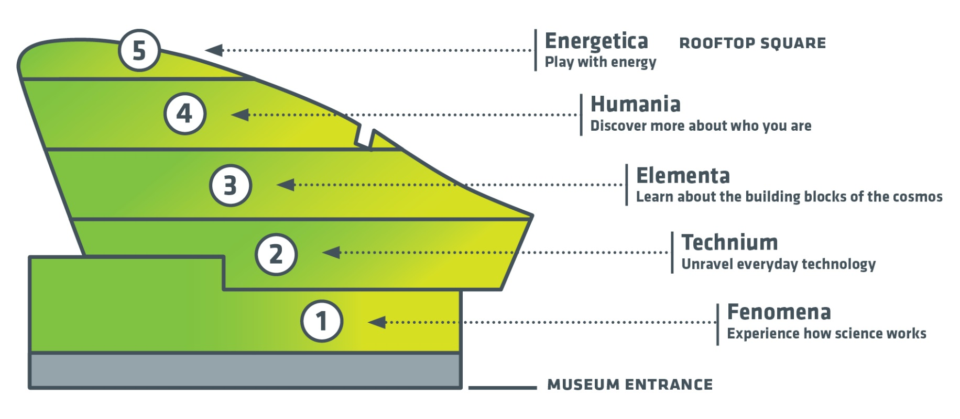
Transformation of the museum: creating a coherent story (2015-2020)

Slide 7
Vision on learning (2014)
Theoretical framework for developing and prototyping new programmes and exhibitions
What is learning?
What kind of visitor experiences do we want to create?
What is NEMO’s approach?
Process of museum practitioners and researchers

Slide 8
learning as visitor experience (2014)
partici-pation
knowledge & insight
in research team
as participant
facts
concepts
abstract insight
identifi-cation
visitor
experience
inquiry
& design
observation
interaction
role playing
observing
manipulating
reasoning
creating
engage-ment
reflection
cognitive
social
emotional
aesthetics
sensory/motor
meta-knowledge
ethics
history
methodology
techniques
Notes:
With the staff of the science learning center we developed a taxonomy of visitor experiences that could cover the rich pallet of learning that can take place in exhibitions, workshops and other activities. One of the main goals was to develop a common language to communicate learning goals of projects and activities. Such that ideas about learning goals can be articulated more precise.

Slide 9
Family learning / offers for different target groups

Slide 10
Fenomena: explore how science works (2015)

Slide 11
Sensational science (2015)

Slide 12
Science throughout the ages (2015)
Notes:
Reflection: is also how the ideas of people / scientists have changed over the centuries.

Slide 13
Science Live: participation in real scientific research
Notes:
Participation: the purpose in this domain is to give the visitor the experience to participate in scientific practice. The participation really contributes to science. The visitor can (partly) conduct research him- or herself, for example by collecting data. But also participate as a subject in the study.

Slide 14
NEMO Research & Development (2015)
Notes:
Research lab at the very heart of our exhibitions. The lab is equipped with cameras, microphones, computers and other facilities that enable research.
First and foremost a concept aimed at integrating research into the professional practice of our science centre.
Facility for science centre staff and university researchers.
Practice-based expertise of the science centre meets research-based insights from behavourial and social sciences.

Slide 15
NEMO R&D: academic research on science learning
Notes:
The science centre provides a useful and appealing addition to more controlled studies or schools-based research. NEMO staff have utilized the UvA’s scientific expertise in neuropsychological development, proportional reasoning, misconceptions and parental guidance to develop new programmes.

Slide 16
NEMO R&D: prototyping as a visitor experience
Notes:
Being part of science in action: learning about scientific processes
Identifying with science: meeting scientists and asking questions
Reflection on their own knowledge, skills and the learning process
Take part and help make NEMO even better: more fun, more surpising and more instructive.
An element of an exhibit about the scientific method Cylinders rolling down a slope (Elles van Vegchel & Rooske Franse)
Prototyping the Content & Presentation
Does the content allow to do systematic experiments?
How to facilitate rich discussions among families? Concept Cartoons; Setup of the Activity

Slide 17
NEMO R&D: prototyping as a visitor experience

Slide 18
NEMO R&D also used by the restaurant!

Slide 19
What are the benefits of a research-informed practice?
Visitors
More engaging and diverse experiences
Actively involved by co-creation
Practitioners
More awareness around learning goals
New insights in informal learning
Researchers
Addition to research in more controlled settings
New research questions arise from practice
Gebruik de knoppen “Lijstniveau verlagen” en “Lijstniveau verhogen” om te wisselen tussen de tekstopmaak

Slide 20
What are the benefits of a research-informed practice?
Organization
Research culture is being encouraged
Development as a centre of expertise
Brand / partners / stakeholders
Recognition as a ‘serious’ place for learning
Profile of an innovative learning organization
Gebruik de knoppen “Lijstniveau verlagen” en “Lijstniveau verhogen” om te wisselen tussen de tekstopmaak

Slide 21
Thank you Amito Haarhuis haarhuis@e-nemo.nl @AmitoH

