Slide 1
NUCLEUS New Understanding of Communication, Learning and Engagement in Universities and Scientific Institutions
September 2015 until August 2019
€4 million funded by HORIZON 2020
Score: 15 Points due to an innovative concept and approach to RRI
Project Lead: Rhine-Waal University, Germany
24 Consortium Members from 14 countries in Europe, South Africa, and China
Partners: Universities, Scientific Institutions, Municipalities, Science and Technology Associations, European Public Engagement Networks
Goals: Recommendations for the Implementation of RRI into the Governance and Culture of Universities and HEIs
An appplicable „DNA“ for RRI

Slide 2
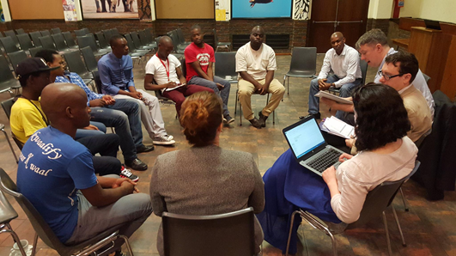
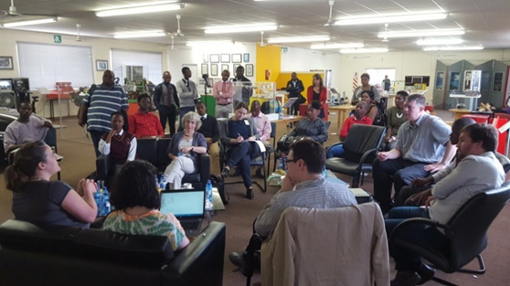
Biggest Success: NUCLEUS Approach
The project describes Academic Instiutions as „Cells“, with the NUCLEUS symbolizing their governance and culture
The new concept of RRI describes the process of „osmosis“ from the core cell to other cells around it
NUCLEUS Field Trips analyse RRI in different „Cells“
Cell 1: Universities (Edinburgh) Cell 2: Public Engagement (Beijing)
Cell 3: Civil Society (Pretoria)
Cell 4: Media (Budapest)
Cell 5: Economy (Dublin)
Cell 6: Policy Making (Nottingham)
2
Notes:
Focusing on the “NUCLEUS” represents our governance-based approach
Different “cells” within society: Universities and Scientific Institutions, Public Engagement Platforms, Civil Society, Media, Public Policy, Economy
These cells have their own specialised skills and goals, but can work together to accomplish more complex tasks than they could individually
We focus on the governance of universities and scientific institutions, but work to understand the interactions between them and their stakeholders
All share a responsibility for research and its outcomes

Slide 3
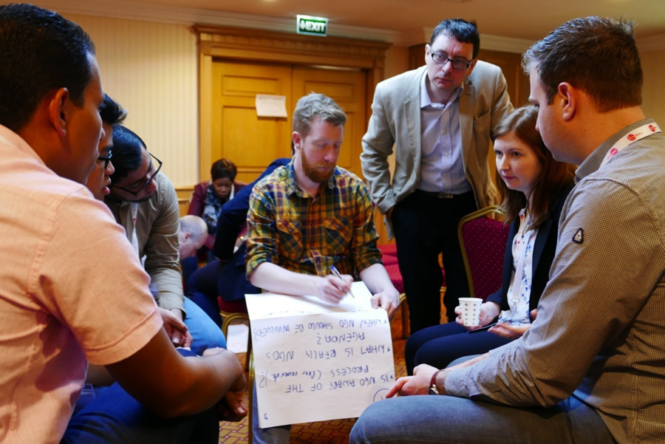
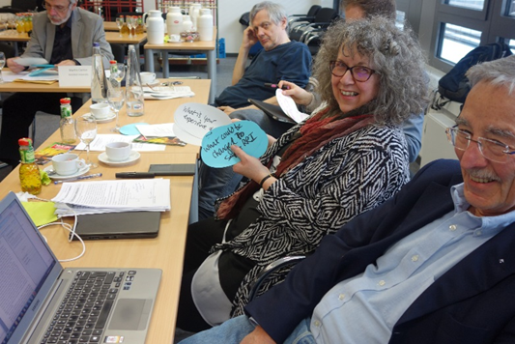
Biggest Challenge – Study on RRI Barriers
NUCLEUS is not a PR project for RRI!
We encourage critical reflections about the willingness of the academic world to apply RRI
We foster a detailed analysis of obstacles and barriers to RRI, including interviews with academic leaders in Europe, China and South Africa
Challenge: Applying the RRI approach within the academic research part of the project: collaborative, transdisciplinary, critical, learning to speak each others‘ language

Slide 4
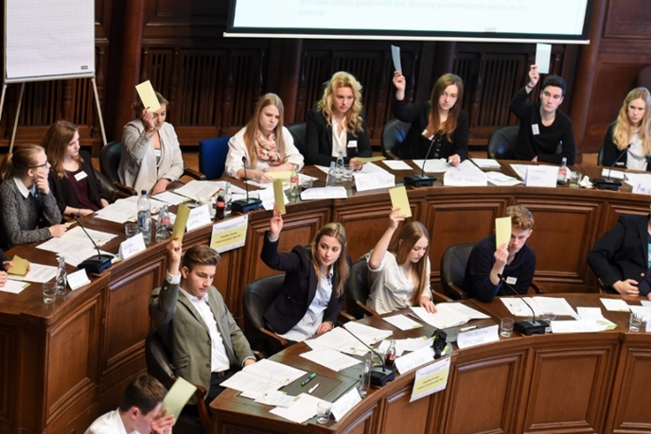
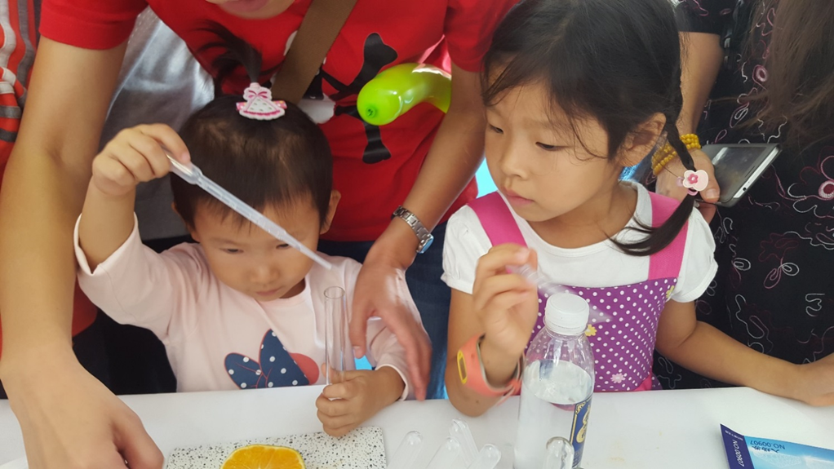
Recommendations
RRI is meant to challenge and transform the definition of Academic Excellence – Public Engagement and Science Communication Activities are not enough!
In order to embedd Responsible Research we need to develop a „DNA“ for RRI - Practical and applicable systemic recommendations, applicable in different contexts.
The implementation of RRI needs to be based on an understanding of academic ways of thinking. The concept should be tested in real academic environments, but also in non-academic contexts, including society!

Slide 5
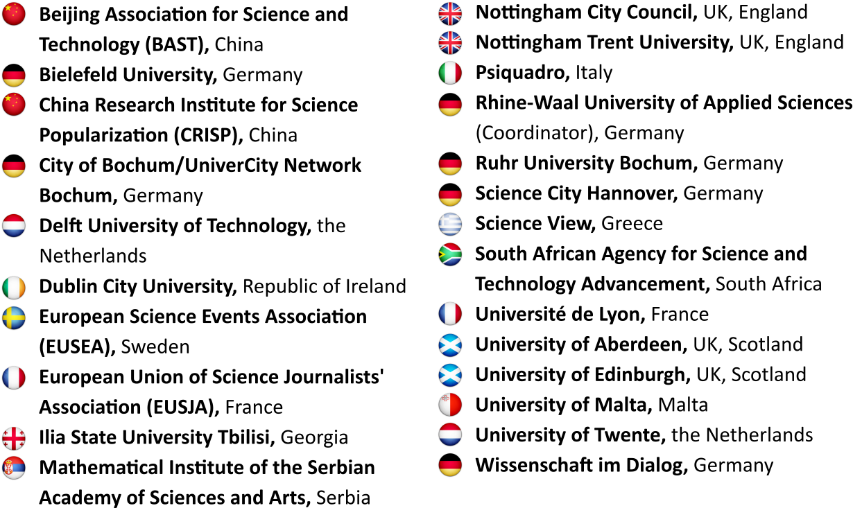
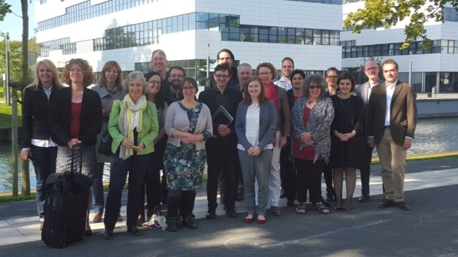
The NUCLEUS Consortium
Project Lead: Prof. Alexander Gerber a.gerber@nucleus-project.eu
Project Manager: Dr. Annette Klinkert a.klinkert@nucleus-project.eu
Dissemination Officer: Robin Yee r.yee@nucleus-project.eu
Financial Officer: Linda van Dijk l.vandijk@nucleus-project.eu

Slide 6
Interested in learning more? Find us online!
http://nucleus-project.eu
http://www.facebook.com/NucleusRRI
http://twitter.com/NucleusRRI
6

