Slide 1
‘Reading children’s minds is possible!’ Kate Phillips
Senior Curator, Science Exhibitions,
Museum Victoria, Melbourne, Australia
Ecsite 2016 Children’s Open Stage 9 June
Twitter: @kateinmelbourne
Travel blog: http://kphillips.travellerspoint.com

Slide 2
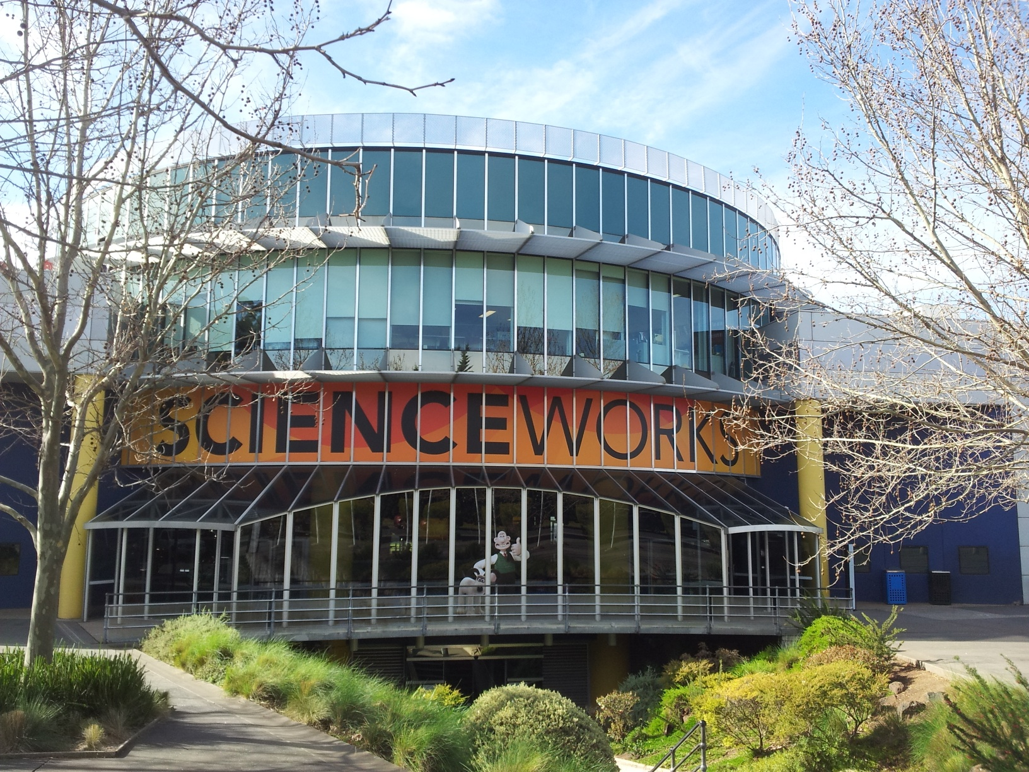

Slide 3
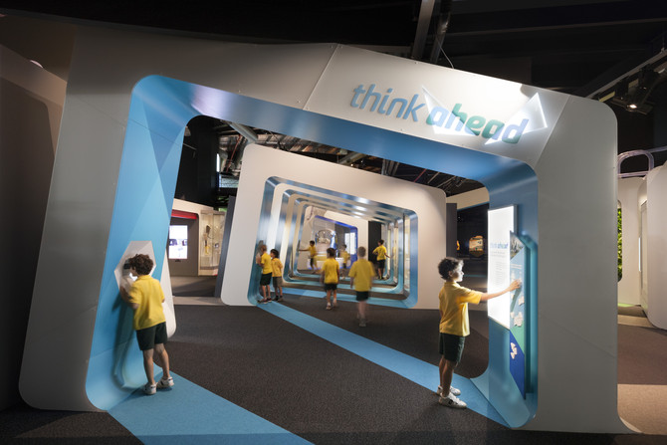
Photographer: Dianna Snape

Slide 4
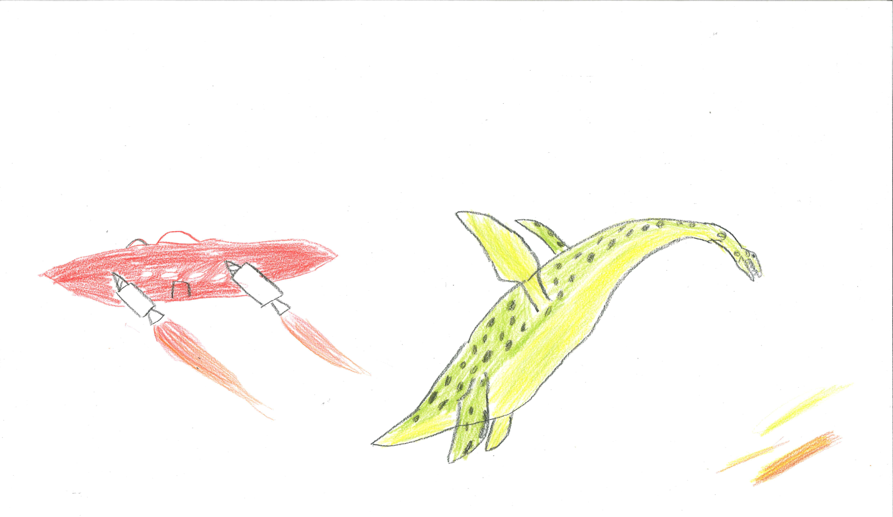

Slide 6
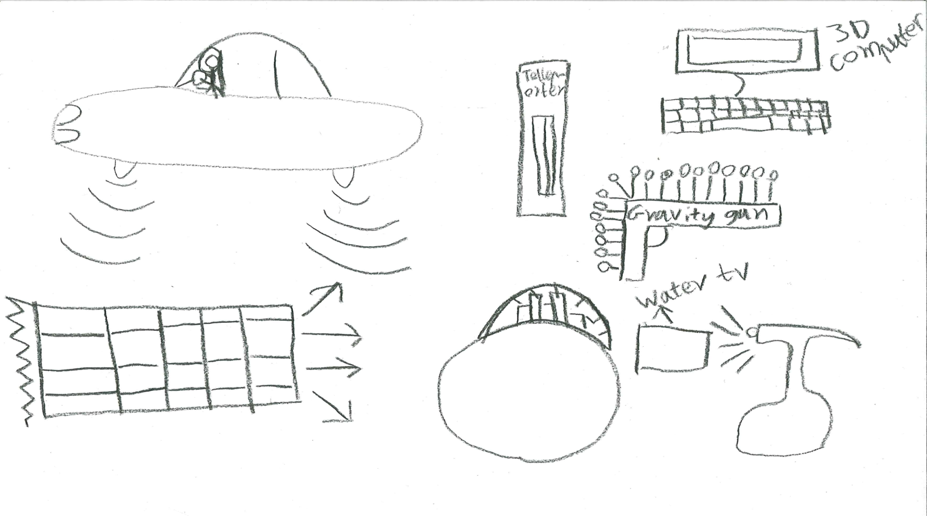

Slide 7
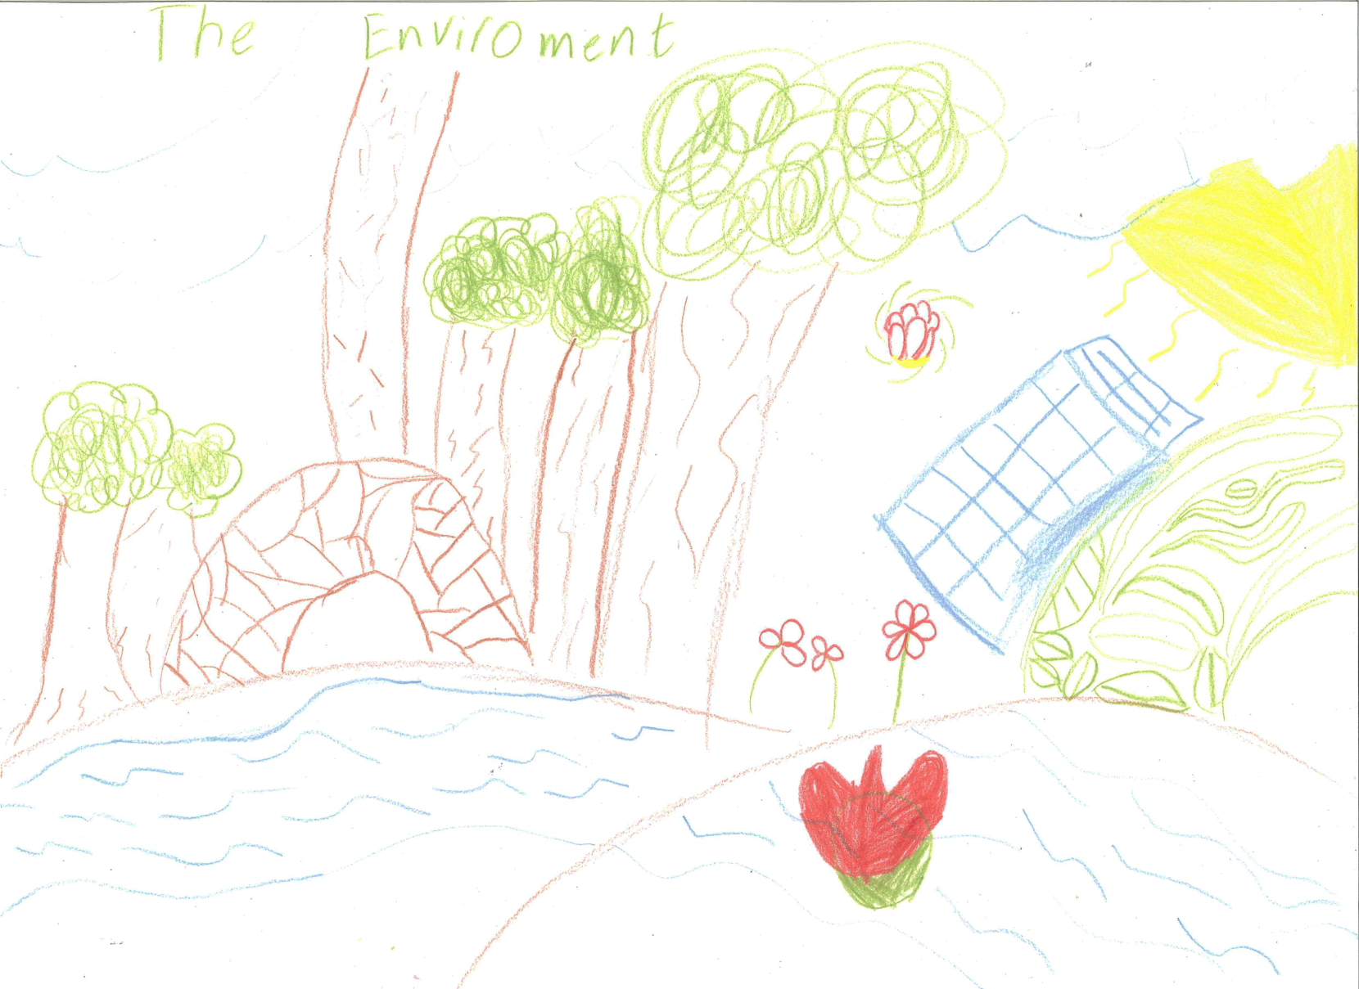

Slide 9
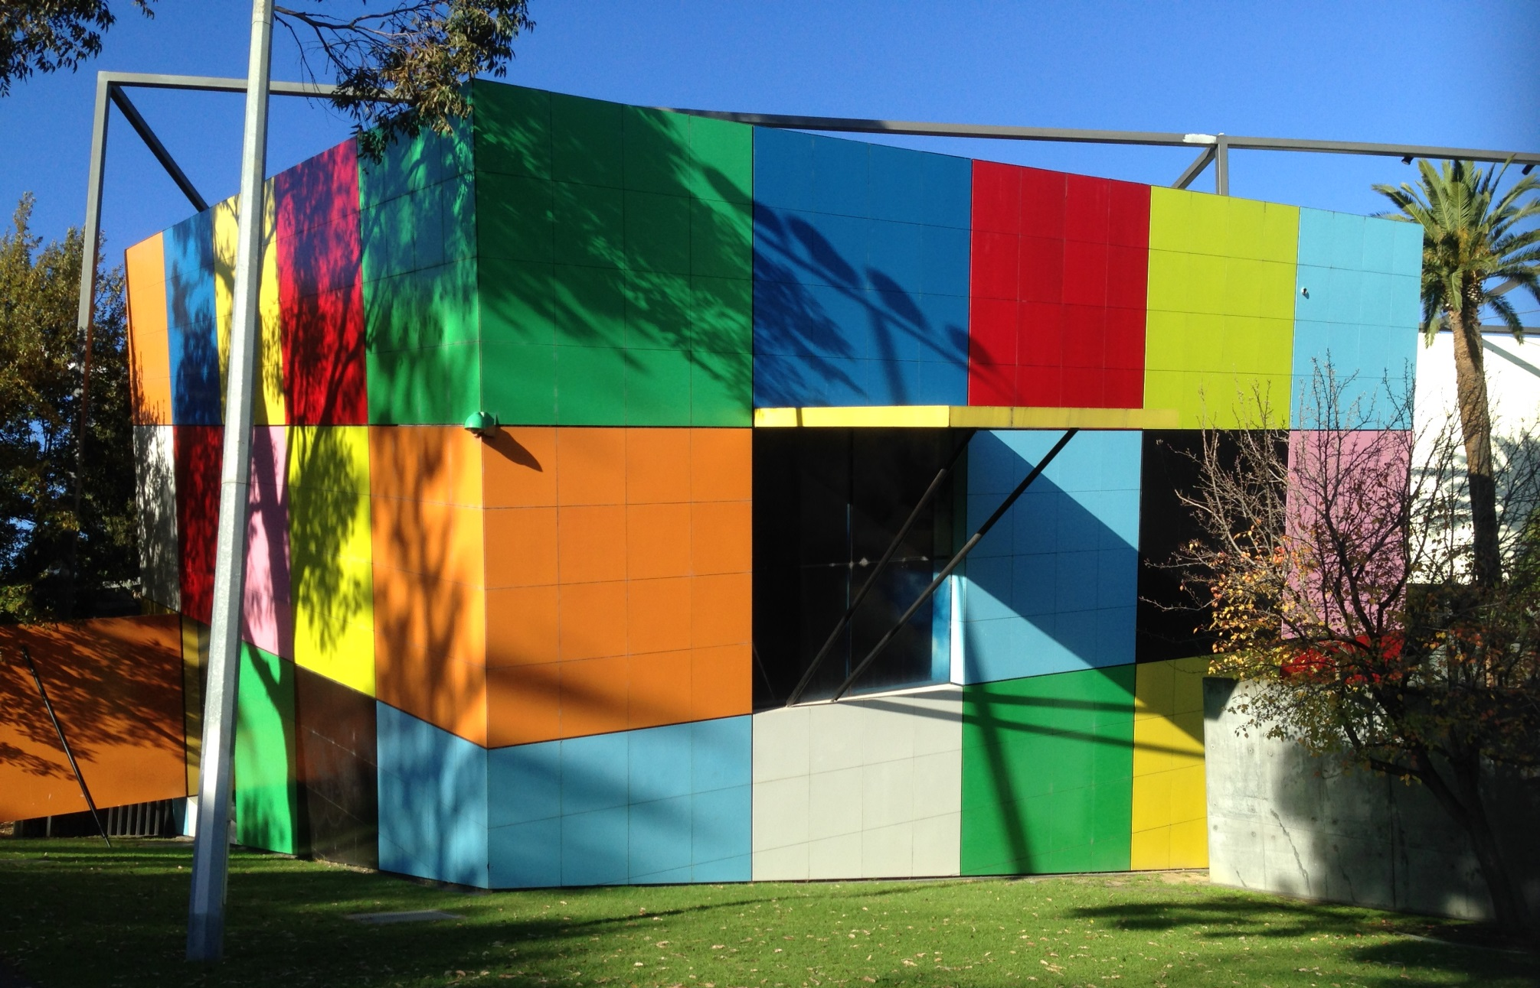

Slide 10
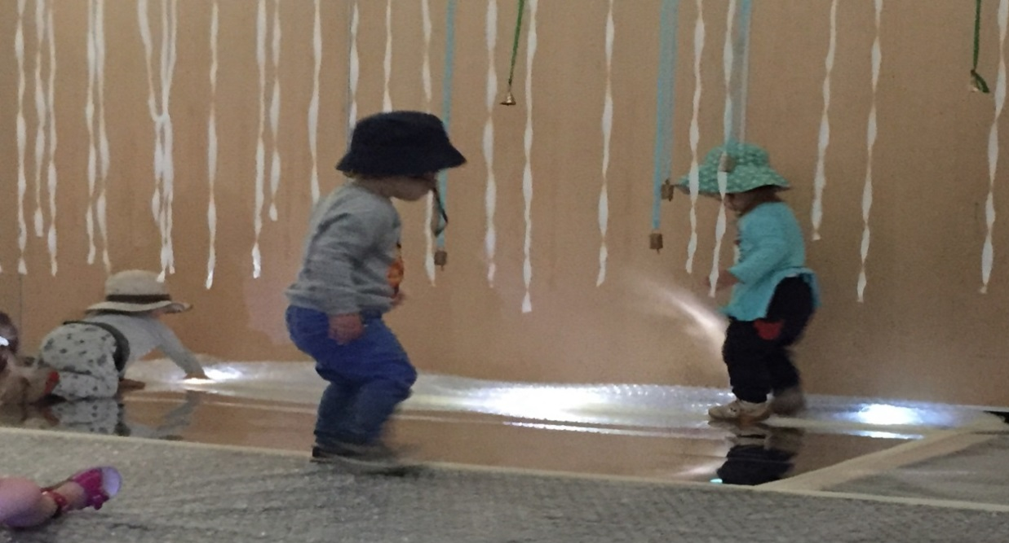
Immersive, sensory experiences – what works for different ages?
Two days at the Gowrie Children’s Centre
With Polyglot Theatre Company set up a whole room
Each day 120 children between the ages of 6 months – 5 years came in for 20 min sessions

Slide 11
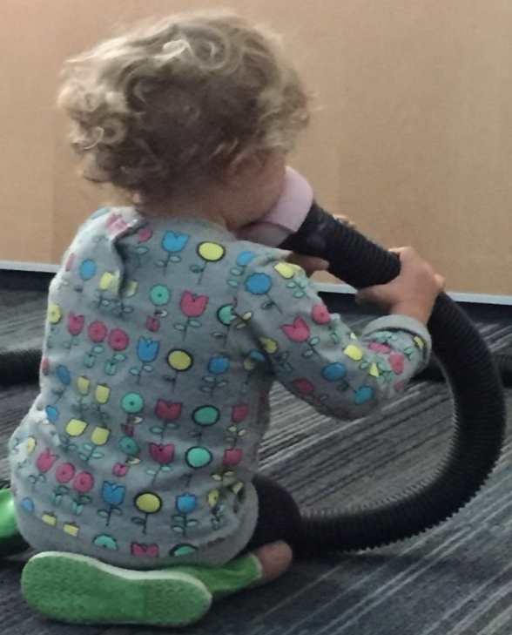

Slide 13
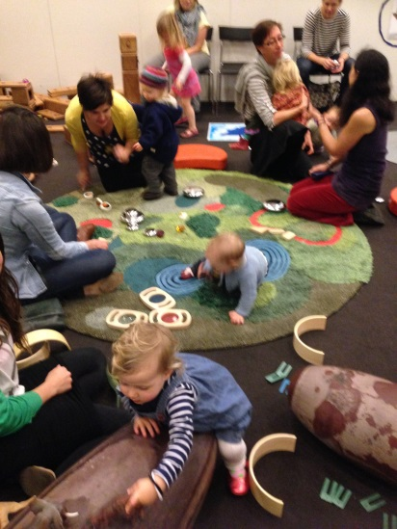
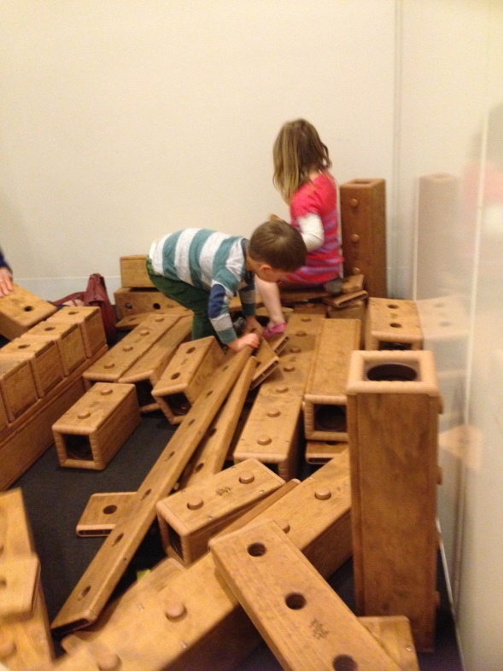
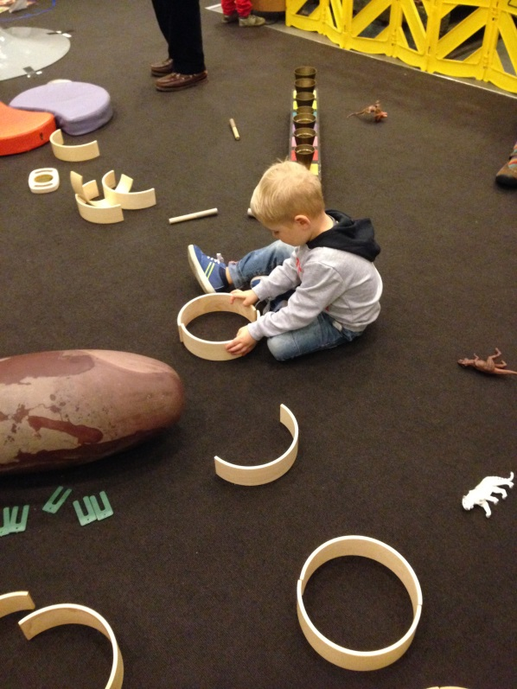
Play with ‘loose parts’
How do kids play with them?
What works for different ages?
Are these blocks too heavy?

Slide 14
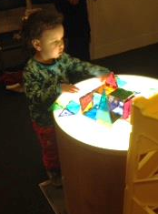
By taking time to ‘read children’s minds’ the exhibition team
Tunes in to a particular audience
Understand their ideas, interests, knowledge
Continually improves exhibits during development, it is an ongoing process
Resolves team differences – the process helps decide between different approaches

Slide 15
Reading children’s minds is possible… and it is worth the time and effort Kate Phillips
Museum Victoria
Twitter: @kateinmelbourne
Travel blog: http://kphillips.travellerspoint.com

