Slide 1
Where are we? How can we progress?
A four-level framework for
inclusion analysis and action
Marianne Achiam & Henriette T Holmegaard
Department of Science Education
University of Copenhagen

Slide 2
Hypatia – Gender Inclusion in Science Education (H2020)
Why is this gender project relevant to a social inclusion and diversity agenda?
Research shows that the way sciences are communicated to young people, in and out of school, is not yet gender inclusive
Hypatia [will] ensure principles of gender inclusivity are embedded in the activities of key organisations across Europe
Hypatia Document of Work, 2015
The Hypatia project has received funding from the European Union’s Horizon 2020 Framework Programme for Research and Innovation (H2020-GERI-2014-1) under the grant agreement No. 665566.

Slide 3
Biological sex
Girls and women
Boys and men
The Hypatia project has received funding from the European Union’s Horizon 2020 Framework Programme for Research and Innovation (H2020-GERI-2014-1) under the grant agreement No. 665566.
Notes:
For a long time, these differences have been used to explain differences found in other areas – including cognitive and intellectual differences. *Boys are better at math’, ‘girls are nurturing’

Slide 4
Biological sex
There is growing evidence that the ‘essential, hardwired differences’ between the two sexes may be a majority opinion rather than a scientific fact.
Choudhury, Nagel, & Slaby, 2009; De Vries, 2004; Grossi, 2008; Ryan, David, & Reynolds, 2004
Cultural sex (or gender)
A concept that refers to the social differences between women and men that have been learned, are changeable over time and have wide variations both within and between cultures.
European Commission 1998:18
The Hypatia project has received funding from the European Union’s Horizon 2020 Framework Programme for Research and Innovation (H2020-GERI-2014-1) under the grant agreement No. 665566.
Notes:
When we talk about the effect of the biological sex on the way we interact with our surroundings, it is more reasonable to talk about cultural sex or gender – gender is a stronger factor in our interactions with the world than whether we have two X chromosomes or an X and a Y

Slide 5
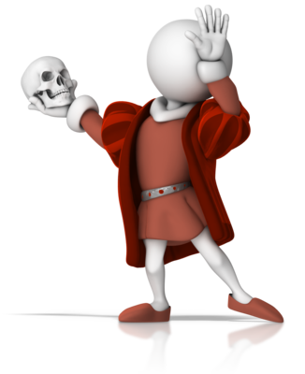
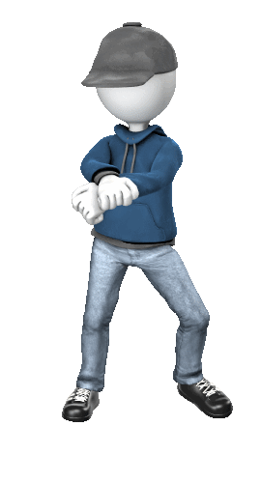
Gender
Rather than the simple translation of biological difference, gender is a complex category that individuals make themselves recognizable through and perform in various ways (Butler, 1990)
The Hypatia project has received funding from the European Union’s Horizon 2020 Framework Programme for Research and Innovation (H2020-GERI-2014-1) under the grant agreement No. 665566.

Slide 6
Gender
Rather than the simple translation of biological difference, gender is a complex category that individuals make themselves recognizable through and perform in various ways (Butler, 1990)
The performance of gender can be thought of as the adaptation of the individual to the cultural context they participate in
Such contexts may impose differential constraints on individuals’ performance of gender
Female people
Male people
Femininity
Masculinity
Gender spectrum
The Hypatia project has received funding from the European Union’s Horizon 2020 Framework Programme for Research and Innovation (H2020-GERI-2014-1) under the grant agreement No. 665566.
Notes:
If we look at how individuals do their gender, we might find that the average female person does their gender in a way that is recognisably feminine, and the average male person does their gender in a way that is recogniseably masculine, but we should also acknowledge the many ways of doing gender that overlap

Slide 7
Example: 12-13 year old boys visiting a science museum
Hegemonic forms of masculinity were privileged and normalized [...] within the visits, for instance, through the physical environment and exhibits, [...] and the competitive and physical nature of some of the hands-on exhibits (p. 476).
Whereas a couple of girls were reprimanded by staff for being too ‘bossy’ (dominant), [...] there were no instances of boys being reprimanded [...] for comparable performances (p. 471).
Archer et al. 2016
The Hypatia project has received funding from the European Union’s Horizon 2020 Framework Programme for Research and Innovation (H2020-GERI-2014-1) under the grant agreement No. 665566.
Notes:
Hegemonic: Ruling or dominant in a social context. Boys performed in dominant and assertive ways towards each other and the girls. The environment (including staff) afforded certain ways of performing gender and constrained others, based on biological bodies.
Ethnicity was a strong factor here - intersectionality

Slide 8
Gendered situations or contexts
Situations or contexts may be structured in ways that reflect implicit or explicit assumptions about the gender of the participants, e.g.
Computer engineering is constructed in terms of the technical, specialist, and abstract (Faulkner 2000)
Many science curricula are pervaded by ‘abstract-rational and frequently mathematical’ accounts of science (Hughes 2001)
These characteristics are often symbolically connected with masculinity
Those individuals (female or male) who do not identify with such characteristics cannot participate on the same terms as for those who do identify with these characteristics

Slide 9
Summary
Gender can be thought of as the way we perform our identities as women or men in specific contexts
These performances can vary from feminine ways of performing identity to masculine ways of performing identity
The contexts in which we find ourselves can themselves be gendered, i.e. they promote certain ways of performing our identities while constraining others

Slide 10
We asked ourselves...
Society/culture
Given that contexts or environments can be gendered (i.e. can promote certain performances and constrain others), how can we ensure that museum/science centre activities are as gender-inclusive as possible?
Gendering structures exist at the societal/cultural level, the institutional level, the interactional level, and the individual level (Risman & Davis 2013; Achiam & Marandino 2014)
Institution
Interaction
Individual

Slide 11
The society/culture level
Ideas about differences based on biological sex are deeply embedded in humanity
E.g. the widespread gender-essentialist ideology that persists across time and space, even in those nations that are most liberal-egalitarian (Charles & Bradley 2009)
This ideology promotes the association of science, technology and engineering with men as well as the dissociation of women from those domains (Correll, 2004; England, 2010; Pronin, Steele, & Ross, 2004)
Society/culture

Slide 12
The institutional level
Society/culture
Even though many science centres and museums subscribe to an inclusion ideology, this is often difficult to implement
Examples include institutions that have embedded exclusionary ‘ways of doing’ in their practices; these are not necessarily perceived as exclusionary by staff members (Machin 2008)
Institution

Slide 13
A closer examination of representations of female animals at one museum suggests that the reasons behind (mis)representation [...] flow from contemporary museum practice
Taxidermy displays reflect the personal views of their makers, rather than representing a balanced view of nature
Machin 2008

Slide 14
The interactional level
Society/culture
Science centres and museums are strongly social settings; the interactions between visitors and staff members, exhibits, and other visitors can prompt and constrain the performance of gender
Gendered ways of interaction include ‘othering’ or adapting a subordinate role (Schwalbe et al. 2000)
Other forms of gender-constraints could be e.g. non-representation in exhibition images, texts, or video
Institution
Interaction
Notes:
treating people of one sex as inherently different; trading one’s status as an equitable group member for membership in the group. We should also think about how to represent all genders equally in the images and texts in the science centre

Slide 15
Some exhibit designs may prompt interaction with equal roles; others may prompt exclusion or ‘othering’

Slide 16
The individual level
Society/culture
Girls and boys internalise norms and become gendered at the individual level This on-going process is influenced by explicit socialisation and modeling (Risman & Davis 2013)
To avoid feeding into the sense that the activities girls and boys meet are ‘not for them’, it is important to avoid building assumptions about gender into activities and encounters
Institution
Interaction
Individual

Slide 17
Summary
Society/culture
Gender is produced, negotiated, and re-negotiated at various levels
Conditions and constraints for gender performance may originate and manifest themselves at different levels
Institution
Interaction
Individual

Slide 18
Example: 12-13 year old boys visiting a science museum
Hegemonic forms of masculinity were privileged and normalized [...] within the visits, for instance, through the physical environment and exhibits, [...] and the competitive and physical nature of some of the hands-on exhibits (p. 476).
Whereas a couple of girls were reprimanded by staff for being too ‘bossy’ (dominant), [...] there were no instances of boys being reprimanded [...] for comparable performances (p. 471).
Archer et al. 2016
The Hypatia project has received funding from the European Union’s Horizon 2020 Framework Programme for Research and Innovation (H2020-GERI-2014-1) under the grant agreement No. 665566.
Notes:
Hegemonic: Ruling or dominant in a social context. Boys performed in dominant and assertive ways towards each other and the girls. The environment (including staff) afforded certain ways of performing gender and constrained others, based on biological bodies.
Ethnicity was a strong factor here - intersectionality

Slide 19
Society/culture
Institution
Interaction
Hegemonic forms of masculinity were privileged through the physical environment
[These] performances of masculinity [...] entailed the subordination of others
Individual

Slide 20
Final words
The four-level framework can help us think about what is within our power to change, and what is not!
It can help us be more systematic in our inquiries into the gender inclusion and exclusion characteristics of our institutions
Even though the framework was developed for gender inclusion, once we begin to consider gender as a performance that is co-determined by the contexts we find ourselves within, we can see how ethnicity, nationality, age, etc are co-determinants of the way we perform our identity

Slide 21
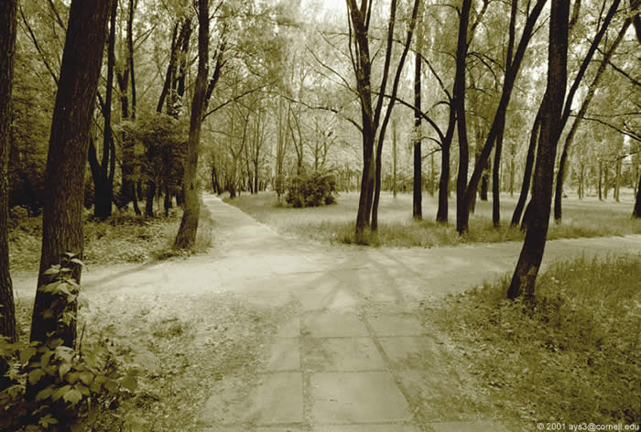
Intersectionality
Intersectionality is the idea that multiple identities intersect to create a whole that is different from the component identities.
These identities that can intersect include gender, race, social class, ethnicity, nationality, sexual orientation, religion, age, mental disability, physical disability, mental illness, and physical illness as well as other forms of identity
Collins 2015

Slide 22
References (1 of 2)
Achiam, M., & Holmegaard, H. T. (2015). Criteria for gender inclusion. Hypatia Deliverable 2.1: Hypatia.
Achiam, M., & Marandino, M. (2014). A framework for understanding the conditions of science representation and dissemination in museums. Museum Management and Curatorship, 29(1), 66-82. doi: 10.1080/09647775.2013.869855
Archer, L., Dawson, E., Seakins, A., DeWitt, J., Godec, S., & Whitby, C. (2016). “I’m being a man here”: Urban boys’ performances of masculinity and engagement with science during a science museum visit. Journal of the Learning Sciences, 25(3), 438-485. doi: 10.1080/10508406.2016.1187147
Butler, J. (1990). Gender trouble - Feminism and the subversion of identity. New York: Routledge.
Charles, M., & Bradley, K. (2009). Indulging our gendered selves? Sex segregation by field of study in 44 countries. American Journal of Sociology, 114(4), 924-976. doi: doi:10.1086/595942
Choudhury, S., Nagel, S. K., & Slaby, J. (2009). Critical neuroscience: Linking neuroscience and society through critical practice. BioSocieties, 4(1), 61-77.
Correll, S. J. (2004). Constraints into preferences: Gender, status, and emerging career aspirations. American Sociological Review, 69(1), 93-113.
Crain, R., Loomis, M., & Ogawa, R. T. (2013). How hands-on implicitly informs “what counts” as science. In B. Bevan, P. Bell, R. Stevens & A. Razfar (Eds.), LOST Opportunities: Learning in Out-of-School Time (pp. 265-278). Dordrecht: Springer Netherlands.
De Vries, G. J. (2004). Sex differences in adult and developing brains: Compensation, compensation, compensation. Endocrinology, 145(3), 1063-1068. doi: 10.1210/en.2003-1504
England, P. (2010). The gender revolution. Gender & Society, 24(2), 149-166. doi: 10.1177/0891243210361475
The Hypatia project has received funding from the European Union’s Horizon 2020 Framework Programme for Research and Innovation (H2020-GERI-2014-1) under the grant agreement No. 665566.
Notes:
Hegemonic: Ruling or dominant in a social context. Boys performed in dominant and assertive ways towards each other and the girls. The environment (including staff) afforded certain ways of performing gender and constrained others, based on biological bodies.
Ethnicity was a strong factor here - intersectionality

Slide 23
References (2 of 2)
European Commission. (1998). 100 words for equality. A glossary of terms on equality between women and men. Luxembourg: European Commission.
Faulkner, W. (2000). Dualisms, hierarchies and gender in engineering. Social Studies of Science, 30(5), 759-792. doi: 10.1177/030631200030005005
Grossi, G. (2008). Science or belief? Bias in sex differences research. In C. Badaloni, A. Drace, O. Gia, C. Levorato & F. Videtto (Eds.), Underrepresentation of women in science and technology (pp. 93-106). Padova: Cleup.
Hughes, G. (2001). Exploring the availability of student scientist identities within curriculum discourse: An anti-essentialist approach to gender-inclusive science. Gender and Education, 13(3), 275-290. doi: 10.1080/09540250120063562
Machin, R. (2008). Gender representation in the natural history galleries at the Manchester Museum. Museum & Society, 6(1), 54-67.
Pronin, E., Steele, C. M., & Ross, L. (2004). Identity bifurcation in response to stereotype threat: Women and mathematics. Journal of Experimental Social Psychology, 40(2), 152-168. doi: 10.1016/S0022-1031(03)00088-X
Risman, B. J., & Davis, G. (2013). From sex roles to gender structure. Current Sociology Review, 61(5-6), 733-755. doi: 10.1177/0011392113479315
Ryan, M. K., David, B., & Reynolds, K. J. (2004). Who cares? The effect of gender and context on the self and moral reasoning. Psychology of Women Quarterly, 28(3), 246-255. doi: 10.1111/j.1471-6402.2004.00142.x
Schwalbe, M., Holden, D., Schrock, D., Godwin, S., Thompson, S., & Wolkomir, M. (2000). Generic processes in the reproduction of inequality: An interactionist analysis*. Social Forces, 79(2), 419-452. doi: 10.1093/sf/79.2.419
The Hypatia project has received funding from the European Union’s Horizon 2020 Framework Programme for Research and Innovation (H2020-GERI-2014-1) under the grant agreement No. 665566.
Notes:
Hegemonic: Ruling or dominant in a social context. Boys performed in dominant and assertive ways towards each other and the girls. The environment (including staff) afforded certain ways of performing gender and constrained others, based on biological bodies.
Ethnicity was a strong factor here - intersectionality

