Slide 1
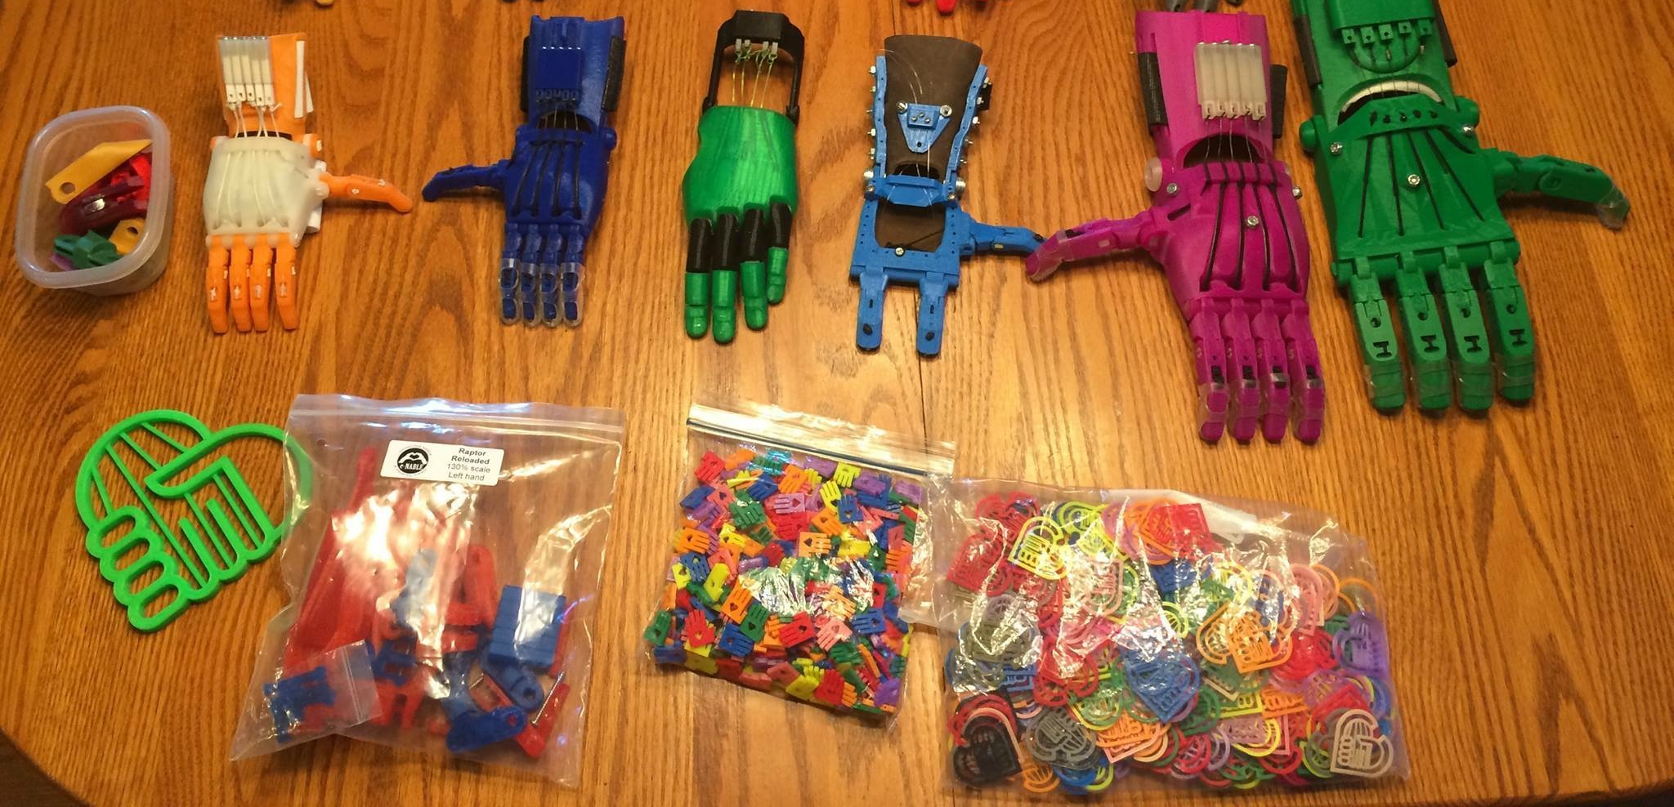
3D Printing in the Service of Disabled Children
Cybèle Robichaud
Project Manager, Exhibitions
Montreal Science Centre
3D Printing in the Service of Disabled Children

Slide 2
Warning!
Notes:
Let me warn you...
The project I'm presenting today is something I would like to develop at our Science Centre.

Slide 3
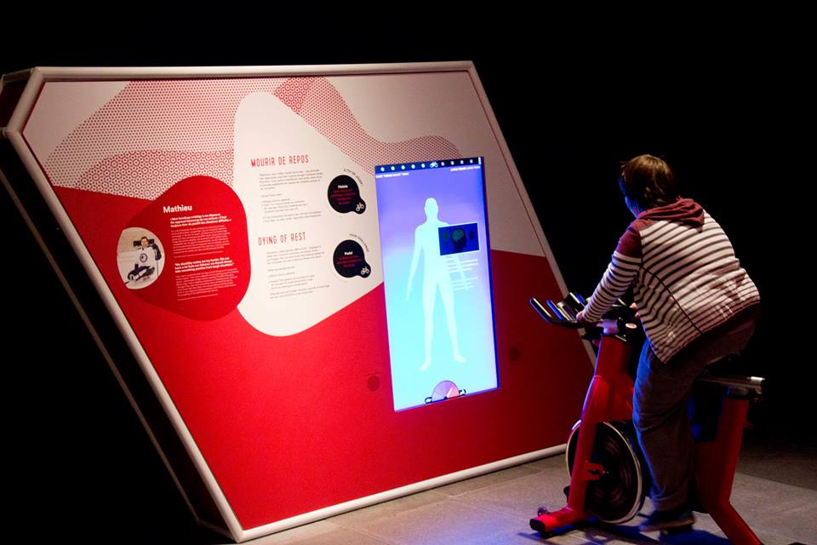
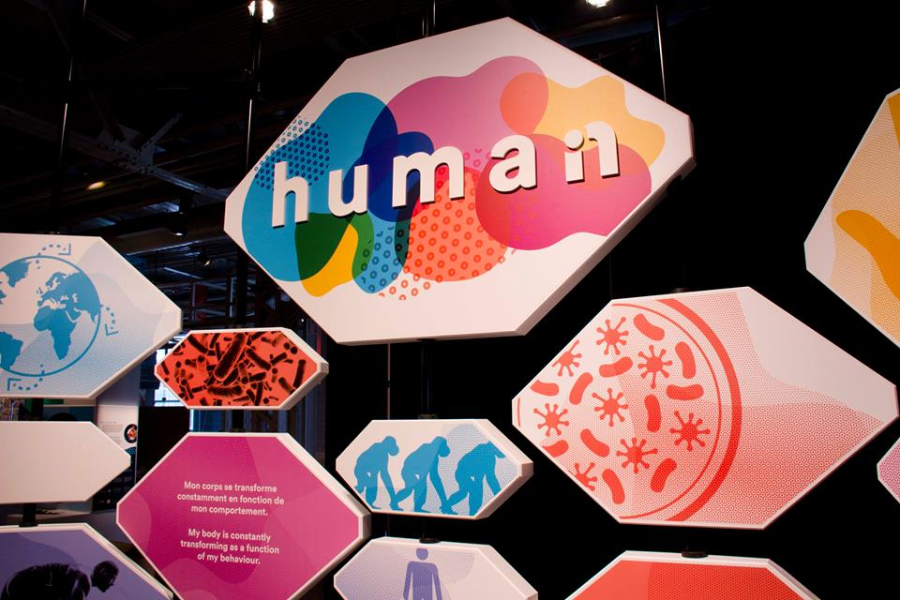
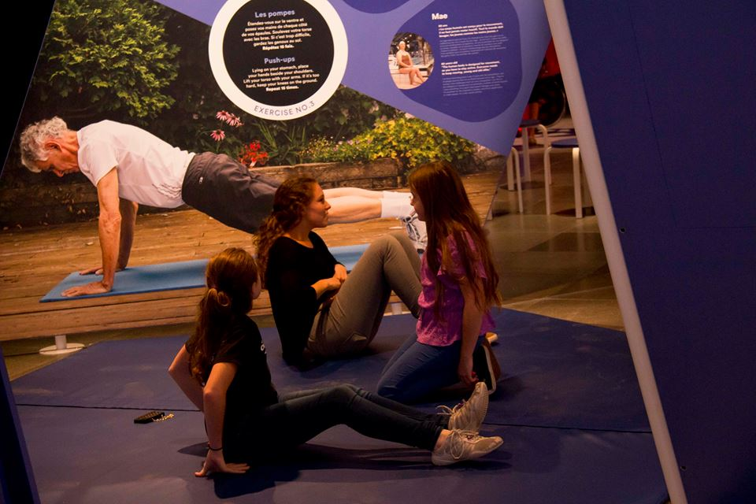
Human Exhibition
Transformation of the human body
Movement
Putting yourself in someone else's skin
Physically engaging interaction
Visitors at the centre of the experience
Notes:
Key phrases of our new permanent exhibition called Human
Transformation of the human body
Movement
Putting yourself in someone else's skin
Physically engaging interaction
Humans at the centre of the experience
In October, we opened 2 areas (Where do we come from ? and Who am I ?)

Slide 4
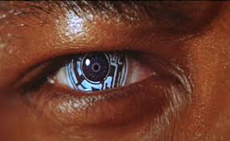
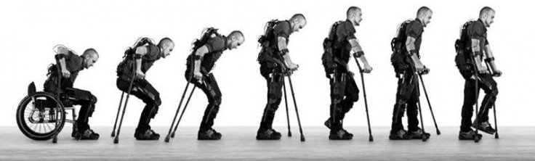
Where are we headed?
Explore how we can transform our bodies through
new technologies
our growing knowledge of the body
Enabling us to
cure sickness and disabilities
improve our physical and mental performance
Notes:
Next winter, we will add another area, exploring the question “Where are we headed”?
This area will explore the ways we can transform our bodies through
new technologies
our growing knowledge of the body
This knowledge and these techniques will enable us to
cure sickness and disabilities
improve our physical and mental performance

Slide 5
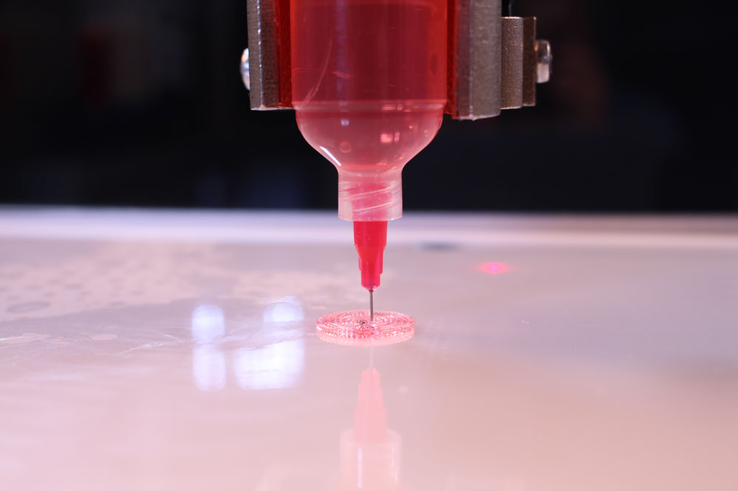
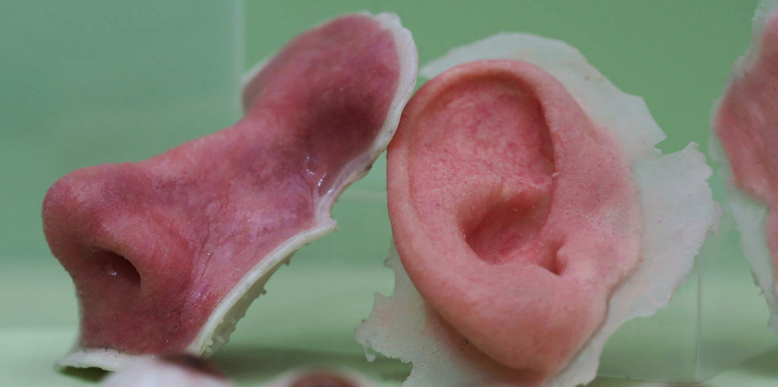
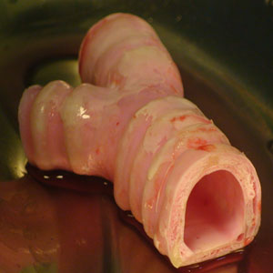
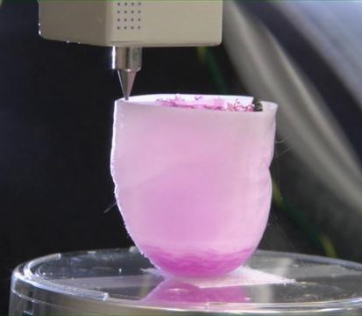
Printing Organs
Notes:
The typical message that accompanies 3D printers is "Now you can print ANYTHING!"
In researching my project on 3D printing, I did discover many applications that eventually will revolutionize our lives (printing organs for example).

Slide 6
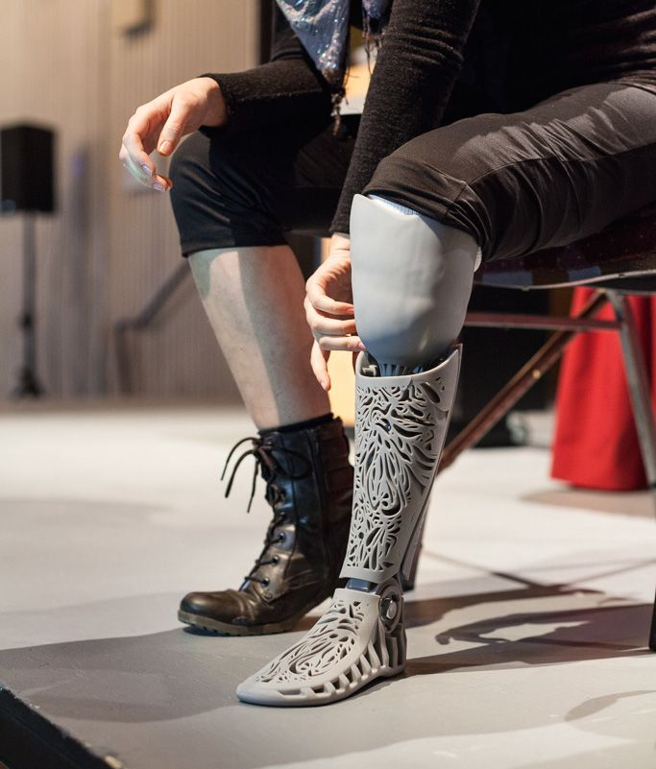
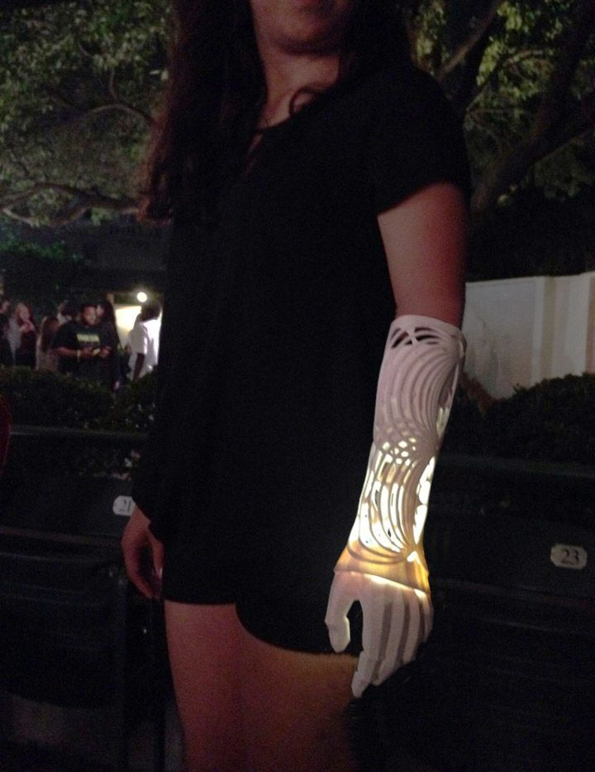
3D printing of prostheses
Notes:
Since we can print anything with a 3D printer, we can also print prosthetics (and it’s more accessible for a science centre than organs printing).
Increasingly, in designing objects for the disabled, the goal is no longer to mask the disability, but rather to celebrate its beauty and uniqueness.
Instead of imitating what's "normal", we embrace another way of being.

Slide 7
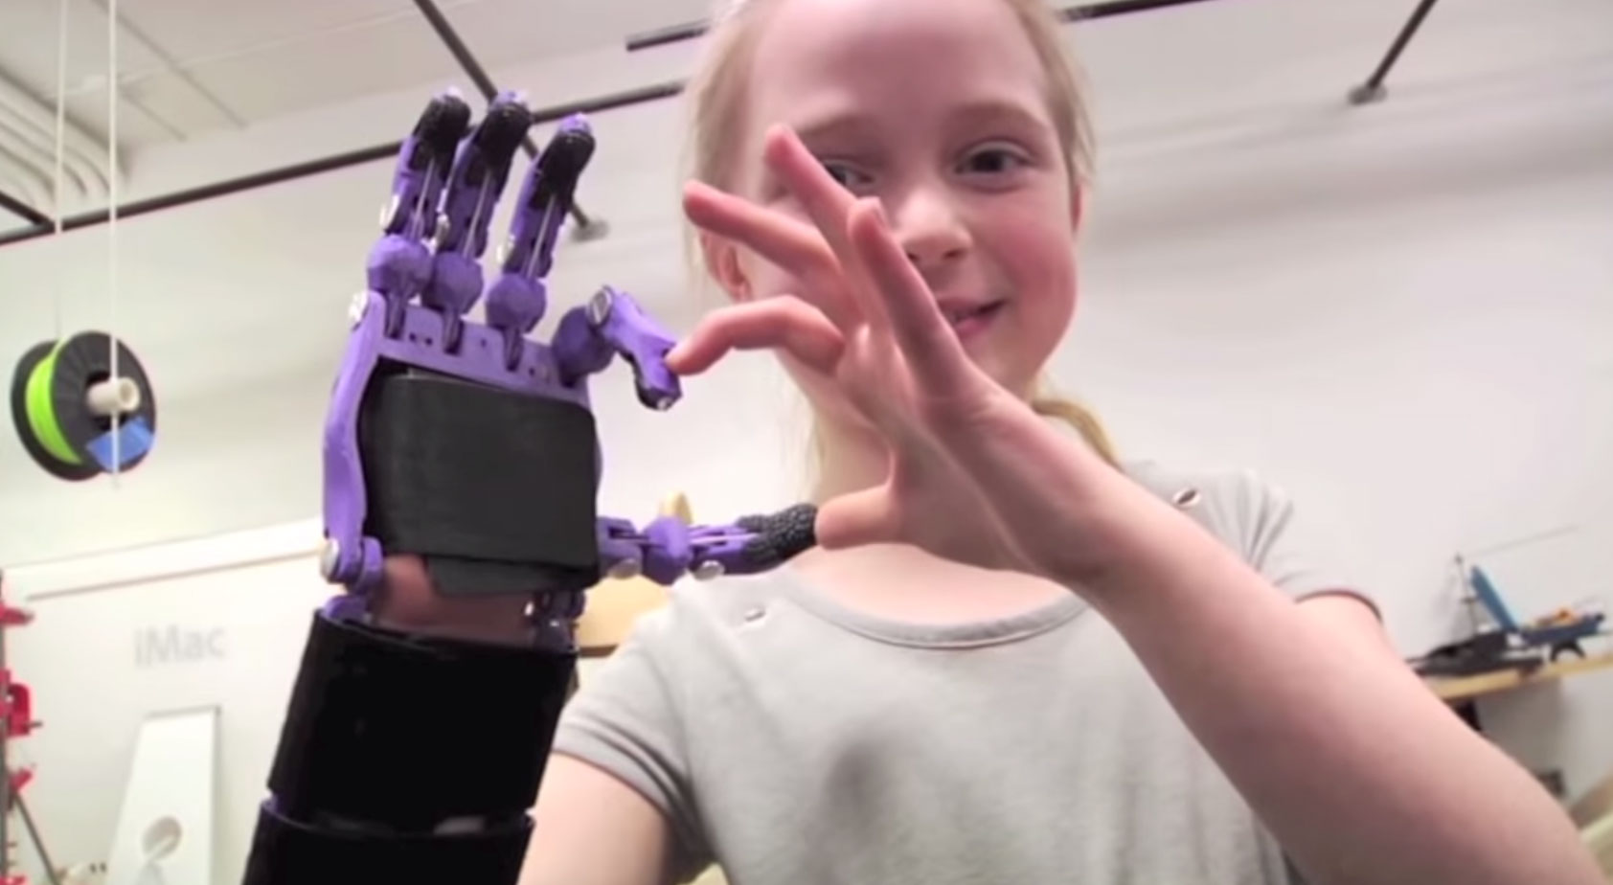
Objectives
What WE want to do with our 3D printer:
Demonstrate the customization of prostheses
Understand how technology can be useful in the service of disabled
DO something useful
Generate smiles and happiness
Notes:
What I think we can do with our 3D printer as a Science Centre:
Demonstrate the customization of prostheses
Understand how technology can be useful in the service of disabled
DO something useful
Generate smiles and happiness

Slide 8
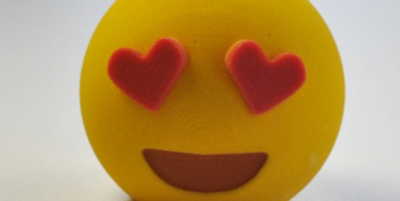
E-nabling the future
Notes:
It was at this point in our thinking and our research on the Web, that I discovered the organization E-nabling the future

Slide 9
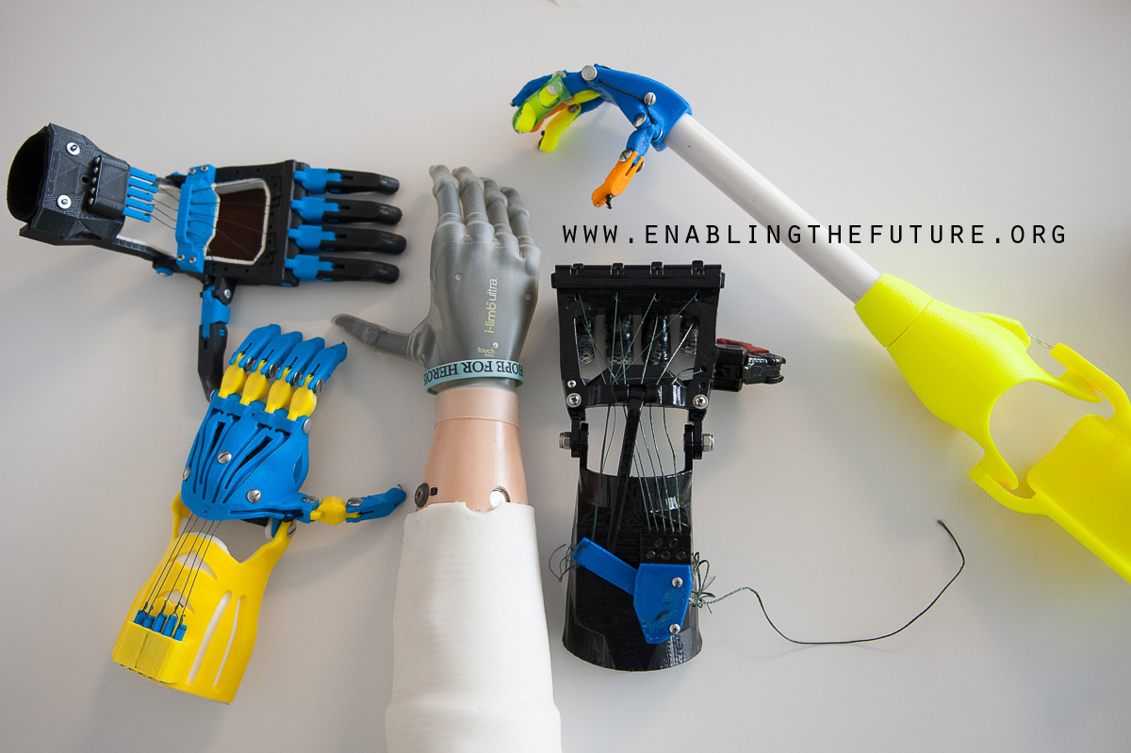
E-nabling the future
Notes:
What?
A worldwide network that uses 3D printing to create custom orthotics for children who are missing a hand
They develop manufacturing files, which they make available to the Web community in open source

Slide 10
For whom?
People who are missing their fingers or arms below the elbow.
Especially helpful for children who do not normally have the option of traditional prosthetic device, due to either cost or time.
Notes:
For whom?
People who are missing their fingers or arms below the elbow
(they must have a functional wrist or elbow).
Especially helpful for children who do not normally have the option of a traditional prosthetic device, due either to cost or time

Slide 11
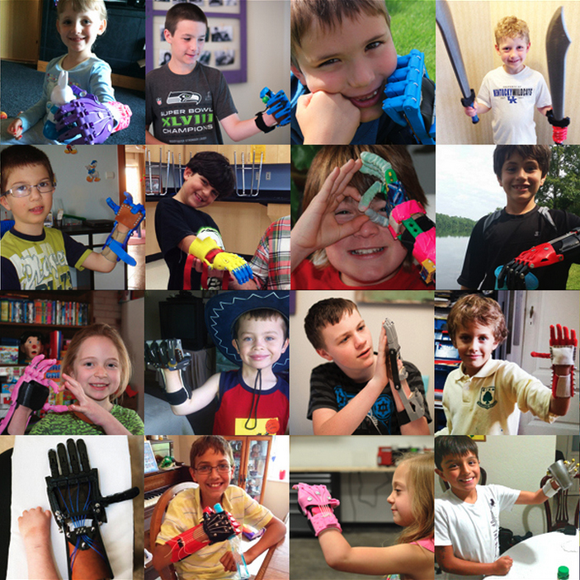
Why?
Notes:
To be able to play without being afraid of breaking an expensive prosthesis
To choose from a wide range of colours
To look cool

Slide 12
How much?
Manufacturing cost
$35- $50 vs $6,000-$10, 000
Production time
6 hours + assembly
A fashion accessory
Notes:
Manufacturing cost
About $35- $50
A professionally made hand can cost around $6,000-$10, 000.
Production time
6 hours + assembly
With these parameters, it becomes a fashion accessory that you can match to your clothes or your mood.
Children wearing this type of prosthesis are proud to attract attention. It’s a way to fully assume their difference and highlight their uniqueness.

Slide 13
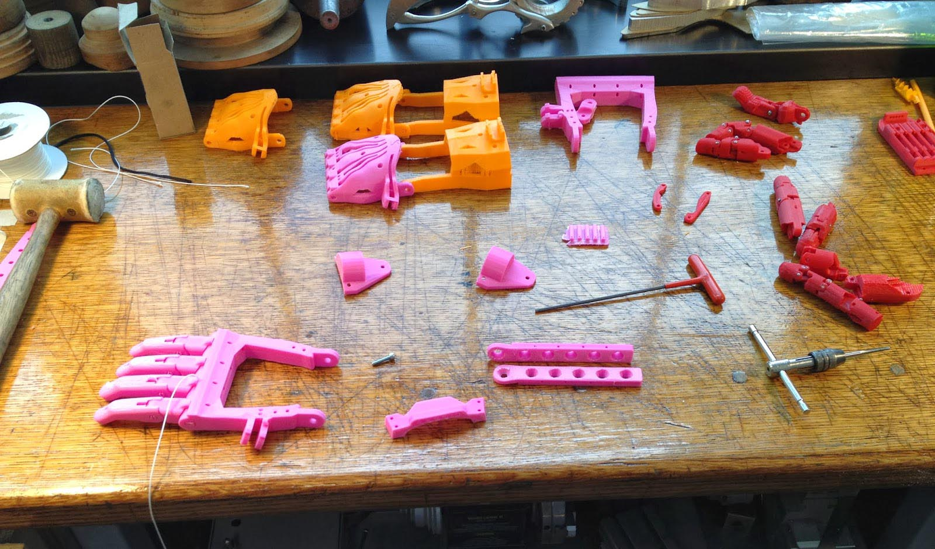
Our project
Become a volonteer in this community of thousands of members in 37 countries
Two or three times a year, offer a prosthetic-making activity: printing, assembling and sending prostheses to children who have submitted a request
Notes:
Become a volunteer in this community of thousands of members in 37 countries
Two or three times a year, offer a prosthetic-making activity: printing, assembling and sending prostheses to children who have submitted a request.
I truly think it’s an innovative and inclusive way to teach technical matters (3D printing) and making a difference in the community at the same time.

Slide 14
Thank you
Notes:
Thank you!

