Slide 1


Slide 2



How can people decide for scientists?

Slide 3


This is all just european project slang…

Slide 4


What do you mean by Research and Innovation?

Slide 5

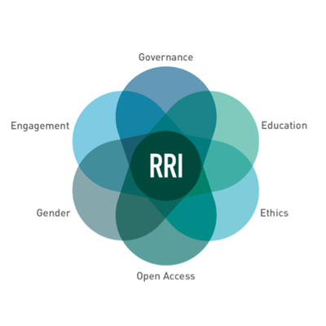
How can we do RRI if we have more basic issues with all the policy agendas?

Slide 6



Make science
MORE COMPLICATED!

Slide 7


Wiktor Gajewski
Art and Science Events Director

